Slide 1

26th International Conference on Computer and Information Technology (ICCIT 2023)
An Attention-Based Deep Learning Approach to Knee Injury Classification from MRI Images
Authored By
Kowshik Deb Nath, A. F. M. Minhazur Rahman and Md. Ali Hossain
Department of Computer Science & Engineering
Rajshahi University of Engineering & Technology, Rajshahi Bangladesh
1

Slide 2
CONTENTS
Introduction
Objectives
Related Works
Methodology
Data Set
Evaluation Metrics
Experimental Analysis
Conclusion
Future Work
References

Slide 3
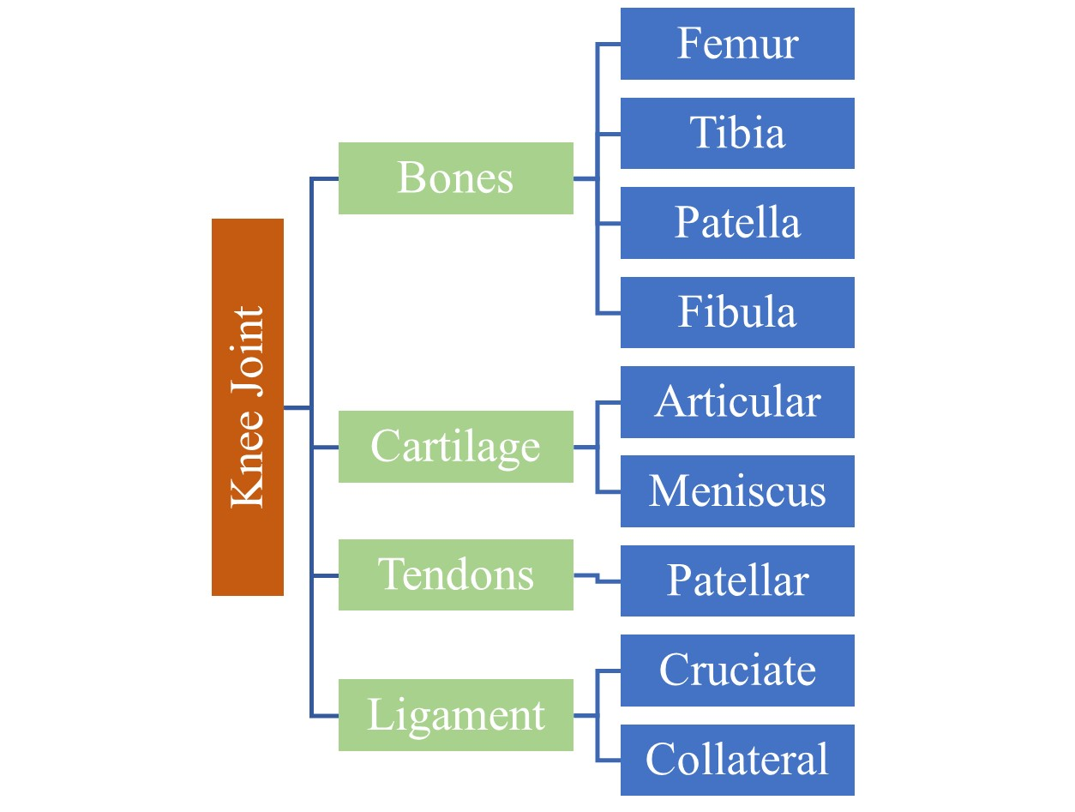
INTRODUCTION
Knee injuries are among the most common injuries in sports and physical activities.
Symptoms:
Pain and swelling
Restricted movement
Popping or crunching noises
Figure 1: Taxonomy of Knee joint anatomy.

Slide 4
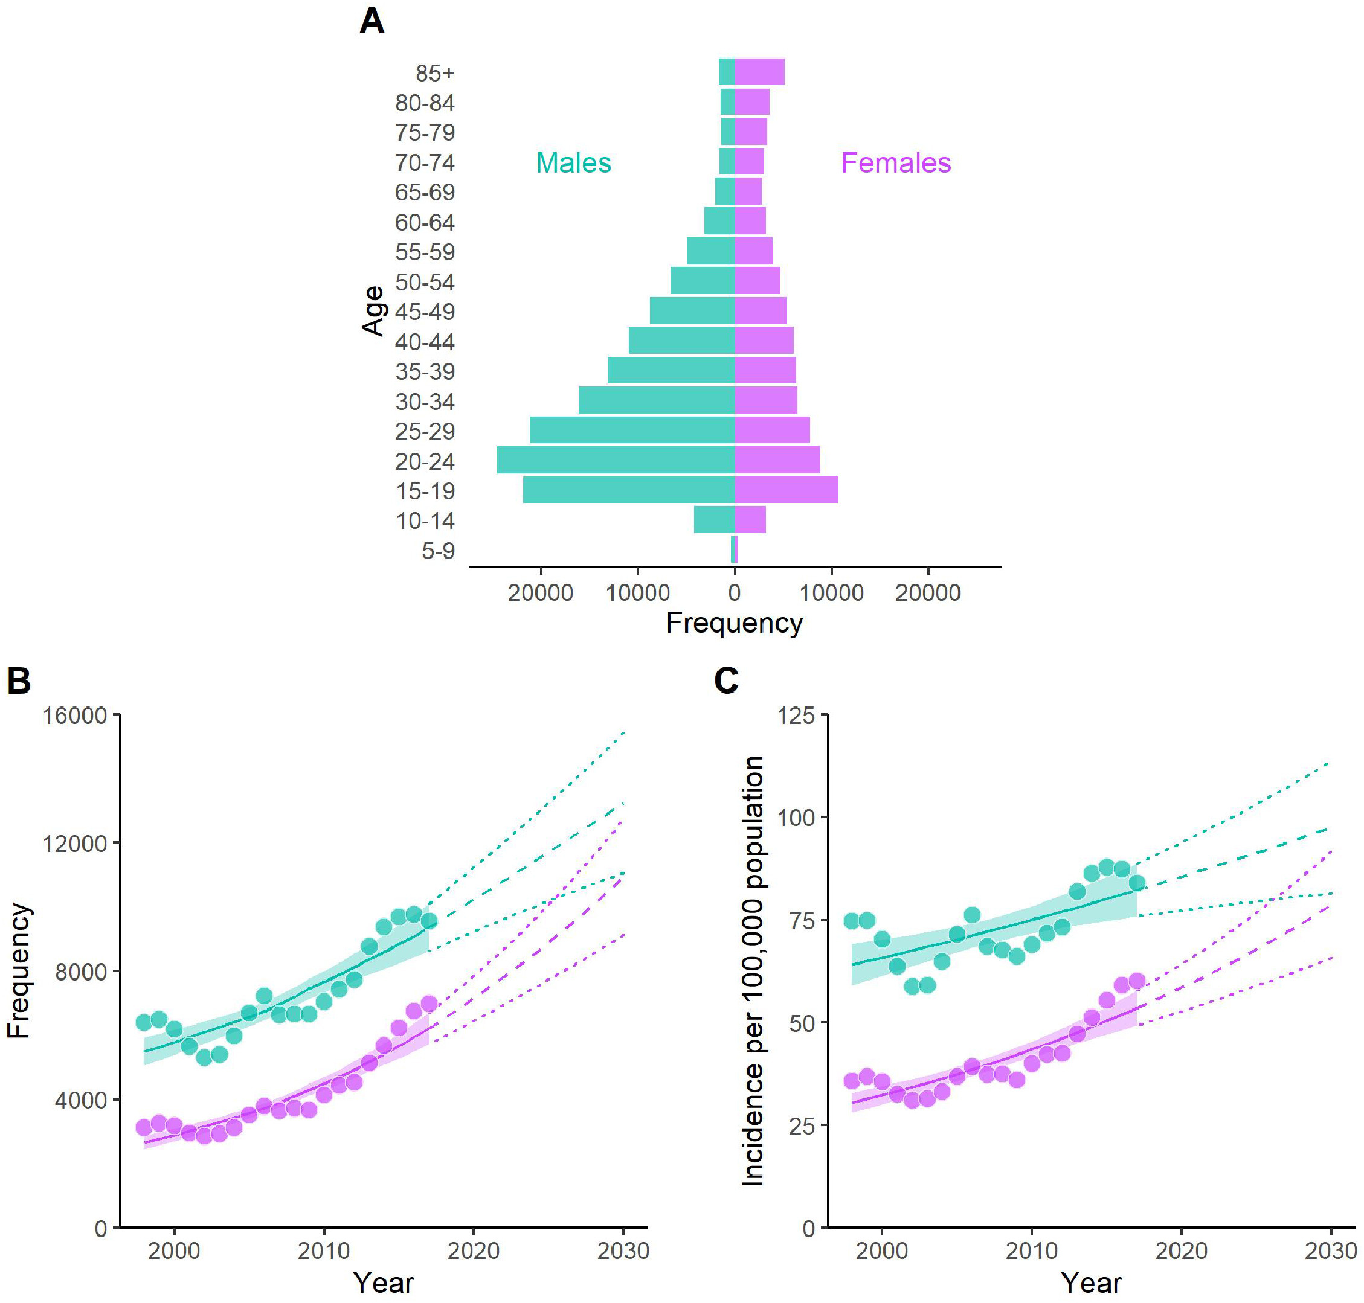
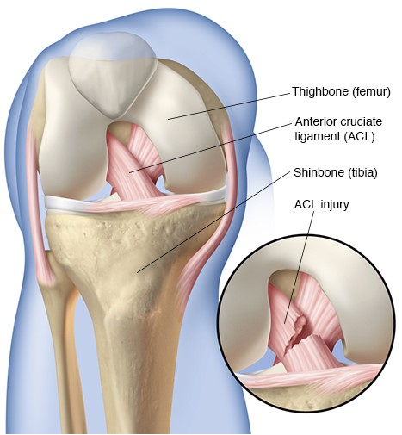
INTRODUCTION(cont’d)
Some Statistics about Knee Injury:
Figure 2: Anterior Cruciate Ligament Anatomy[2].
Figure 3: Knee injuries in Australian hospitals (1998-2018). Panel A) Population pyramid of acute injuries over 20 years for males (green) and females (purple) aged 5+; Panel B) Yearly injury frequency for both genders, projected to 2030-2031; Panel C) Yearly injury rate per 100,000 projected to 2030-2031[1].

Slide 5
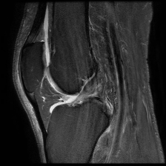
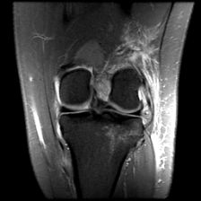
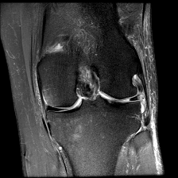
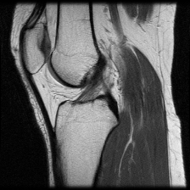
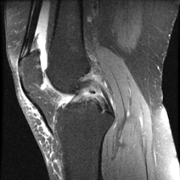
INTRODUCTION(cont’d)
Different Kinds of Knee Injuries:
(a)
(b)
(c)
(d)
(e)
Figure 4: (a) ACL (b) FCL (c) MCL (d) Normal (e) PCL MRI Images

Slide 6
OBJECTIVES
Get high accuracy on the detection of Knee Injury both Binary and Multi-Class Classification
Use the Attention Based Module for accuracy improvement
Compare performance with other models
Classify MRI images:
Binary Classification – ACL and NO_ACL
Multi-Class Classification - ACL, PCL, MCL, Normal and FCL

Slide 7
RELATED WORKS
Table 1: Related works Analysis and findings
Related Works | Ref Paper[3] | Ref Paper[4]
Paper Title | A Torn ACL Mapping in Knee MRI Images Using Deep Convolution Neural Network with Inception-v3 | Multi-Layered Basis Pursuit Algorithms for Classification of MR Images of Knee ACL Tear
Accuracy | 99.04% | 95%
Method Used | DCNN based Inception-v3 | multi-layered Convolutional Sparse Coding(ML-CSC)
Drawbacks | Overfitting High Training Accuracy – 99.04% Low Testing Accuracy – 95.42% | absence of larger labeled datasets. Total: 623 MR Images Complete tear – 205 Normal Tear – 205 Partial Tear - 213

Slide 8
METHODOLOGY
Dataset Collection
Data Preprocessing
Feature Extraction
Model Training
Performance Analysis

Slide 9
DATASET
We have conducted our work into two different datasets:
1. BMEII-AI RedImageNet(Dataset-1) 2. RedImage(Dataset-2)
Table 2: Ground Truth class for DataSet-1(BMEII-AI RedImageNet)
Table 3: Ground Truth classes for DataSet-2 (RedImage)
Class | Samples
ACL | 569
NO ACL | 452
Class | Samples
ACL | 10,085
FCL | 466
MCL | 7,911
Normal | 4,593
PCL | 725

Slide 10
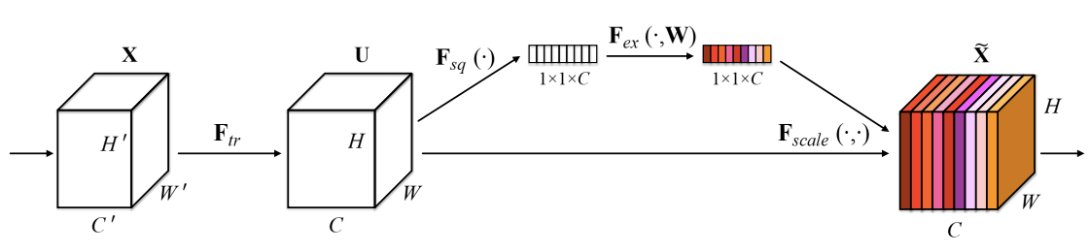
PROPOSED METHODOLOGY
Squeeze-and-Excitation Block:
Squeeze and Excitation Network is a channel-wise attention mechanism that recalibrates each channel accordingly to create a more robust representation by enhancing the important features.
Figure 5: A Squeeze-and-Excitation Block [5].

Slide 11

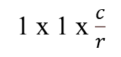

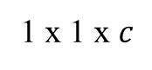
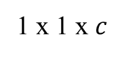
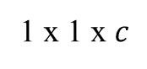
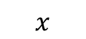


PROPOSED METHODOLOGY(cont’d)
Squeeze and Excitation Network Detailed Diagram:
$$x$$
INPUT
$$H×W×C$$
Global pooling
1 x 1 x $c$
FC
1 x 1 x $\frac{c}{r}$
ReLU
1 x 1 x $\frac{c}{r}$
FC
1 x 1 x $c$
Sigmoid
1 x 1 x $c$
Scale
$$H×W×C$$
$$\tilde{x}$$
Figure 6: A detailed diagram of the Squeeze and Excitation Network with proper dimensions and the different operations.

Slide 12
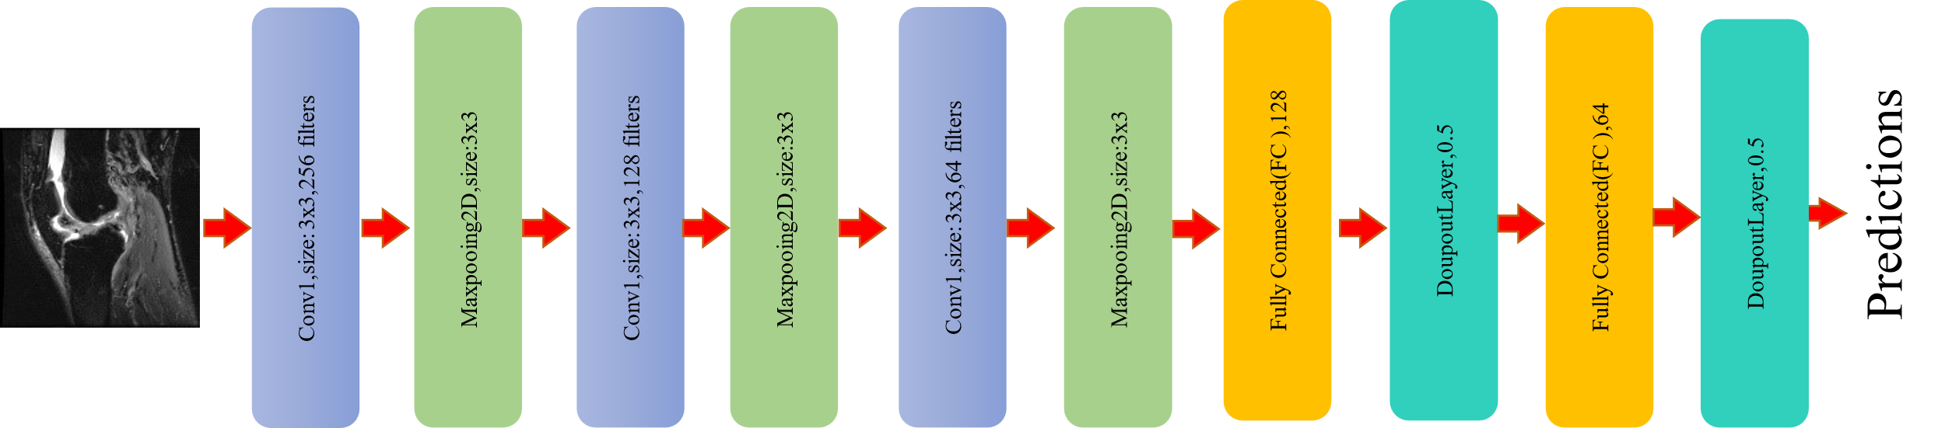
PROPOSED METHODOLOGY(cont’d)
CNN architecture for binary and multi-class classification:
Figure 7: CNN Architecture for Binary Classification for Binary and Multi-Class Classification

Slide 13
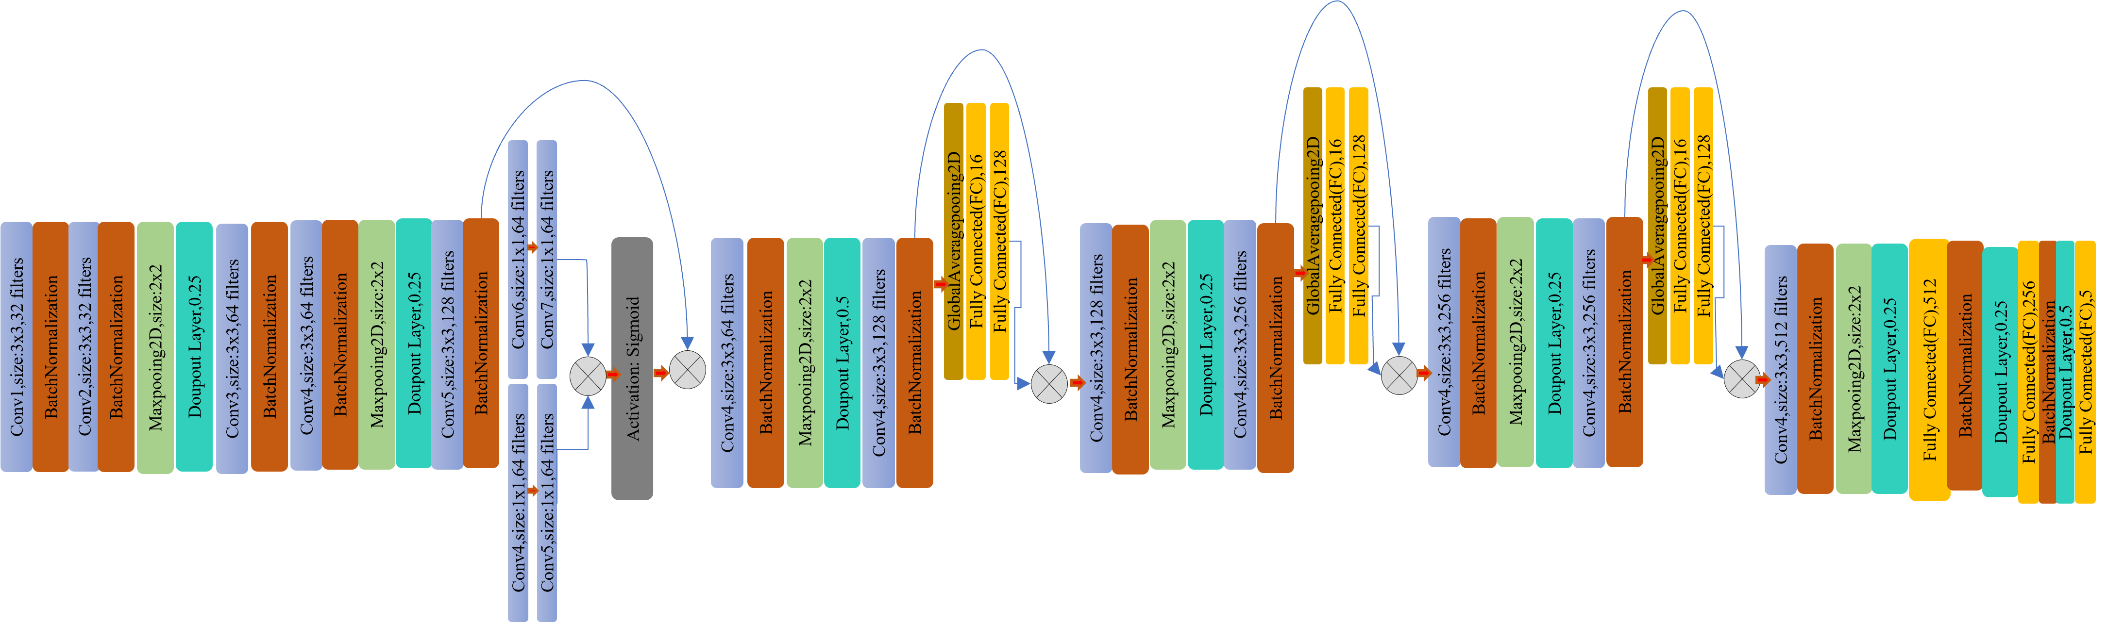
PROPOSED METHODOLOGY(cont’d)
Attention-based CNN architecture for binary and multi-class classification:
Figure 8:Attention-based CNN architecture for binary and multi-class classification

Slide 14
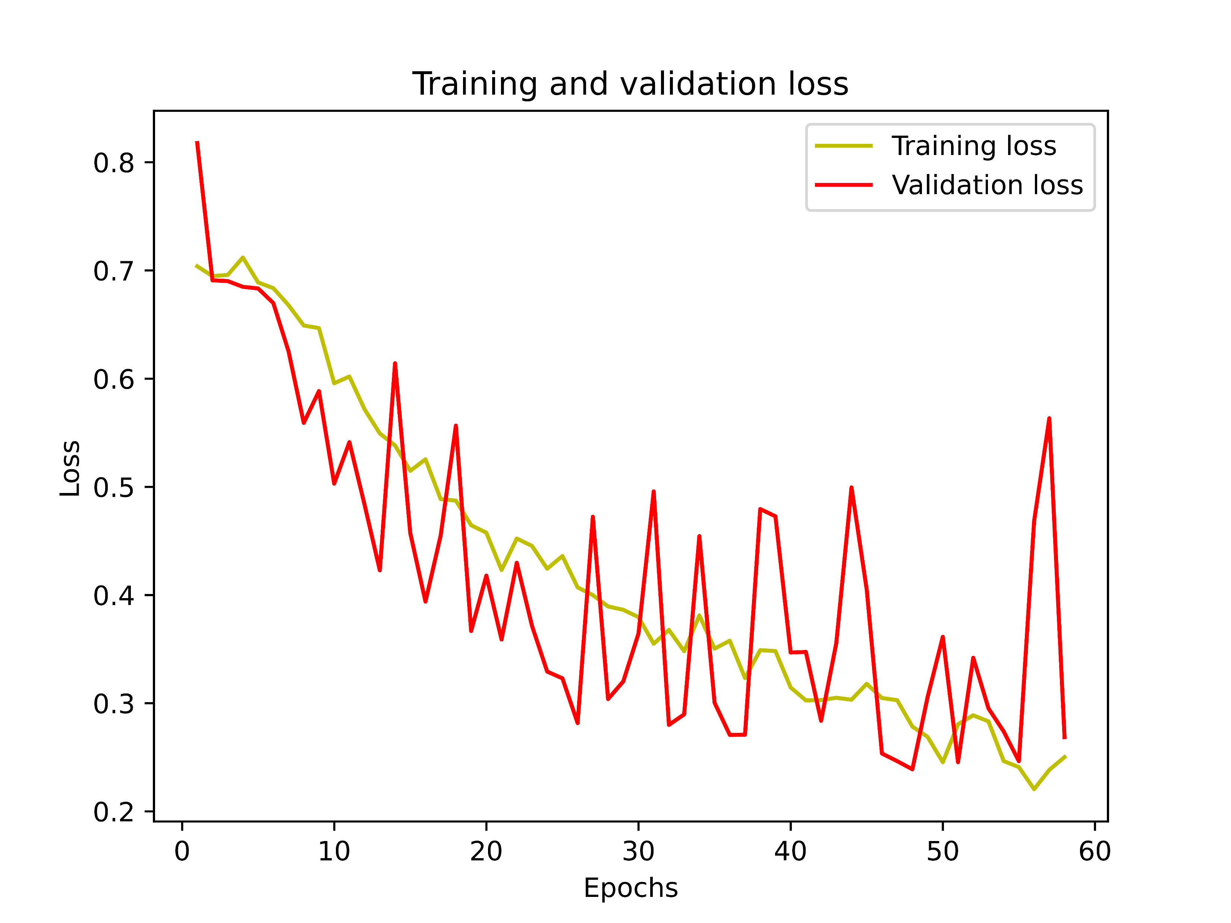
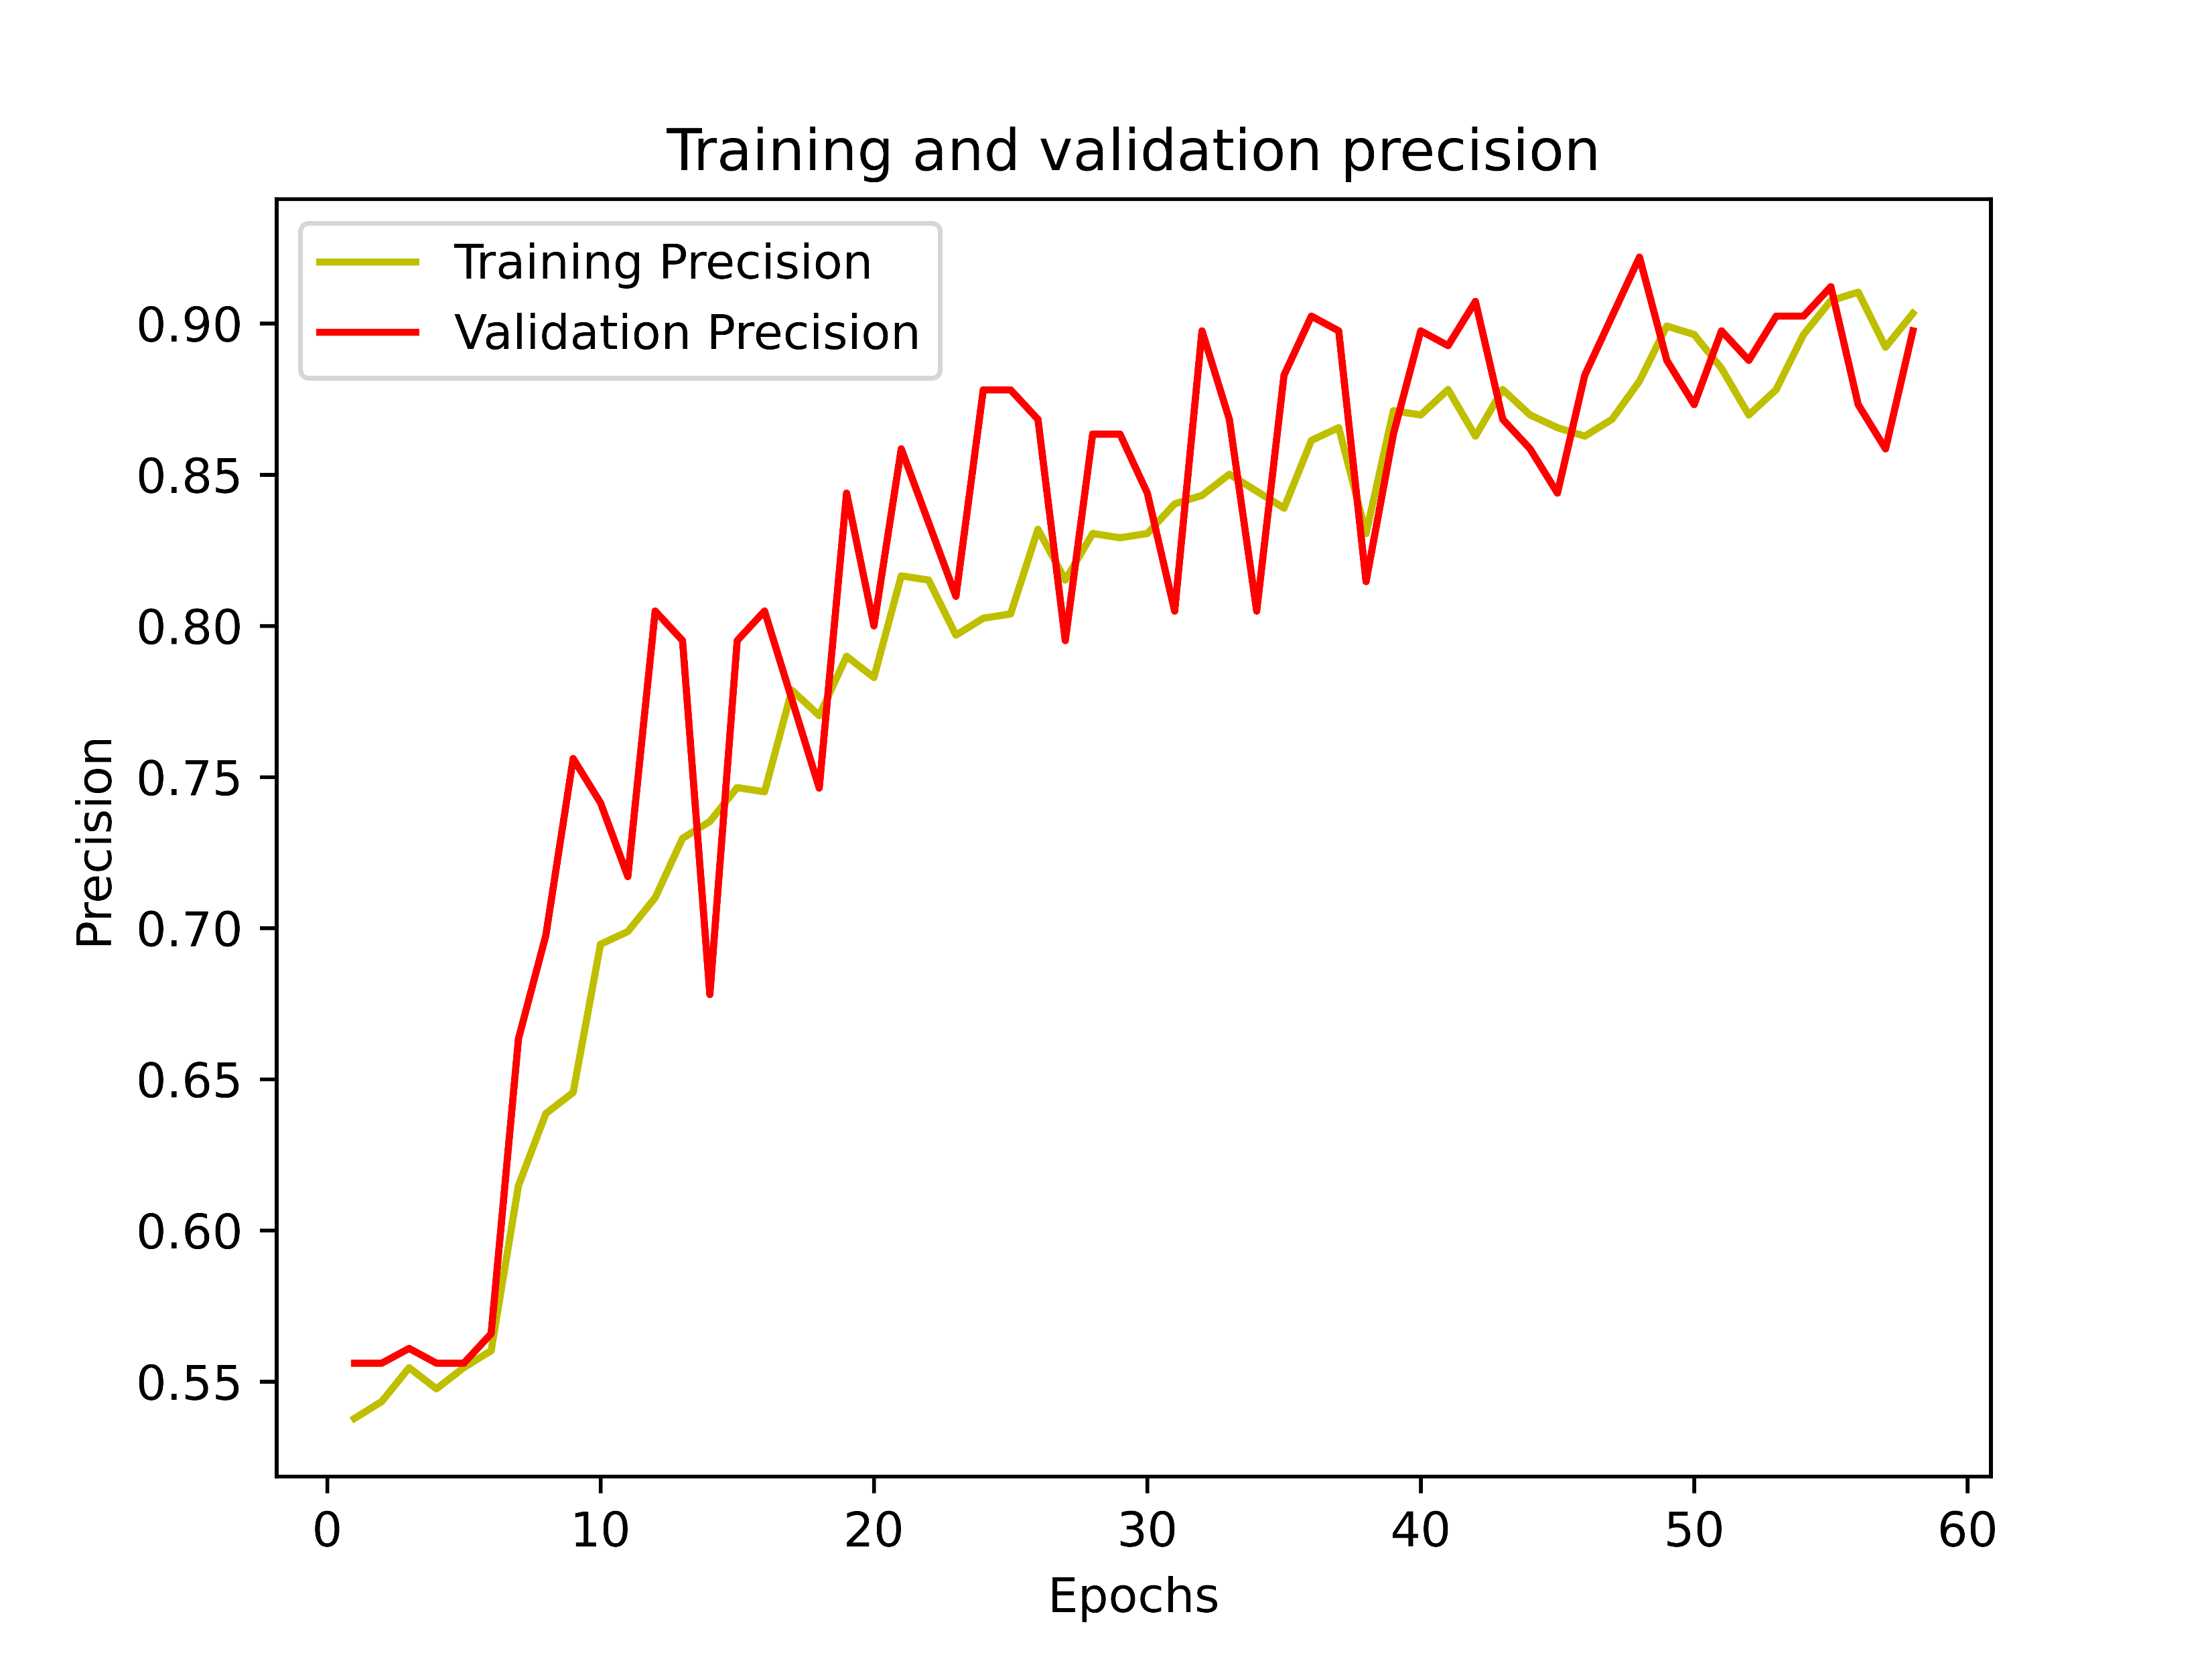

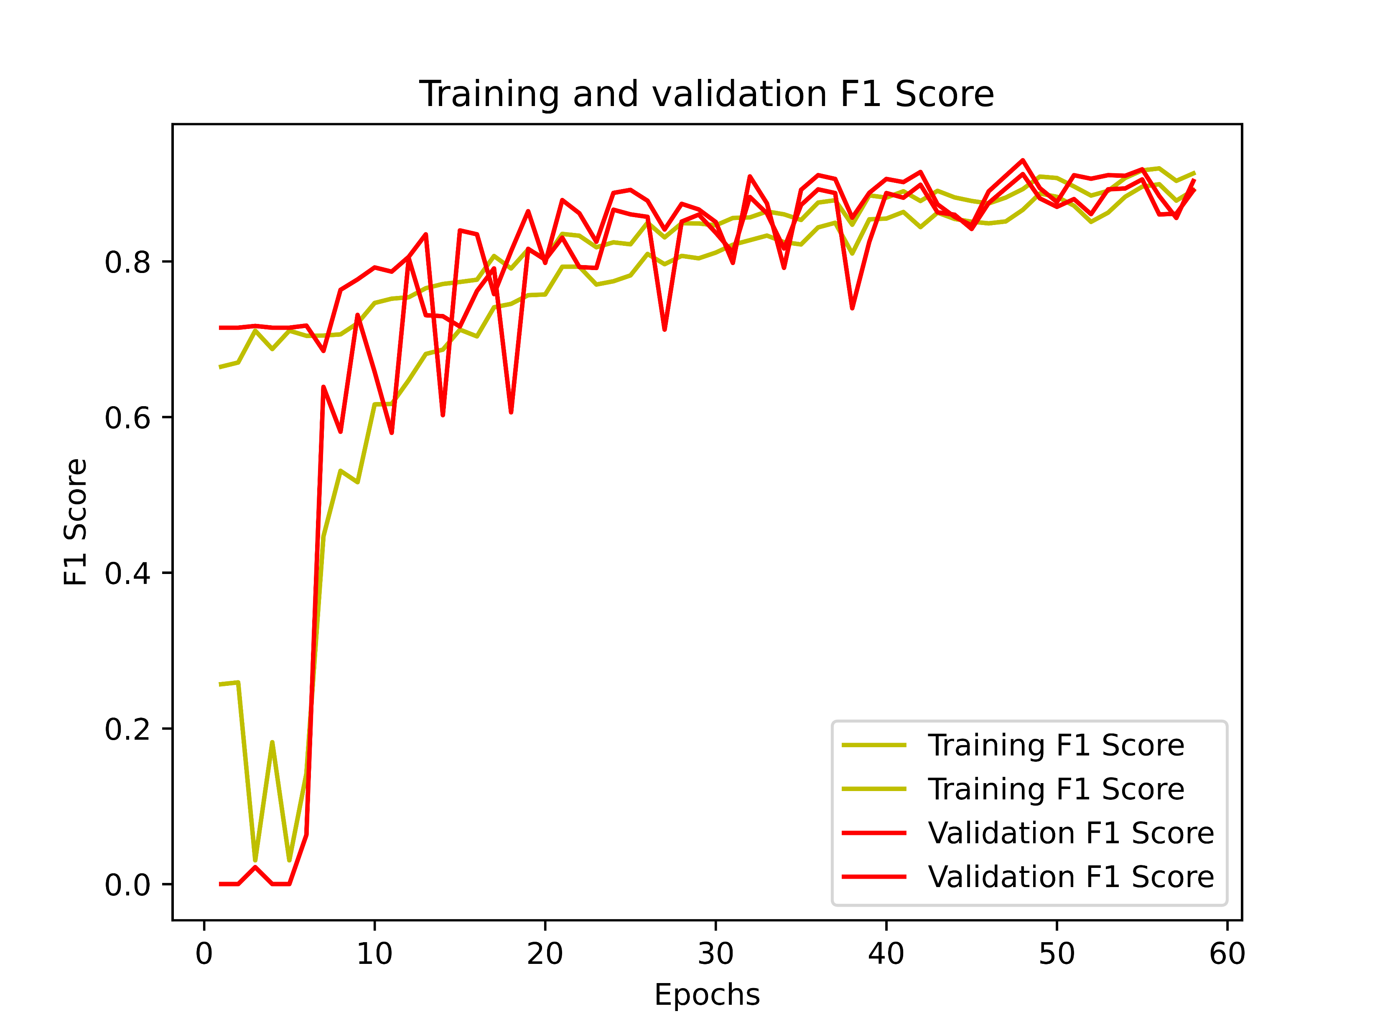
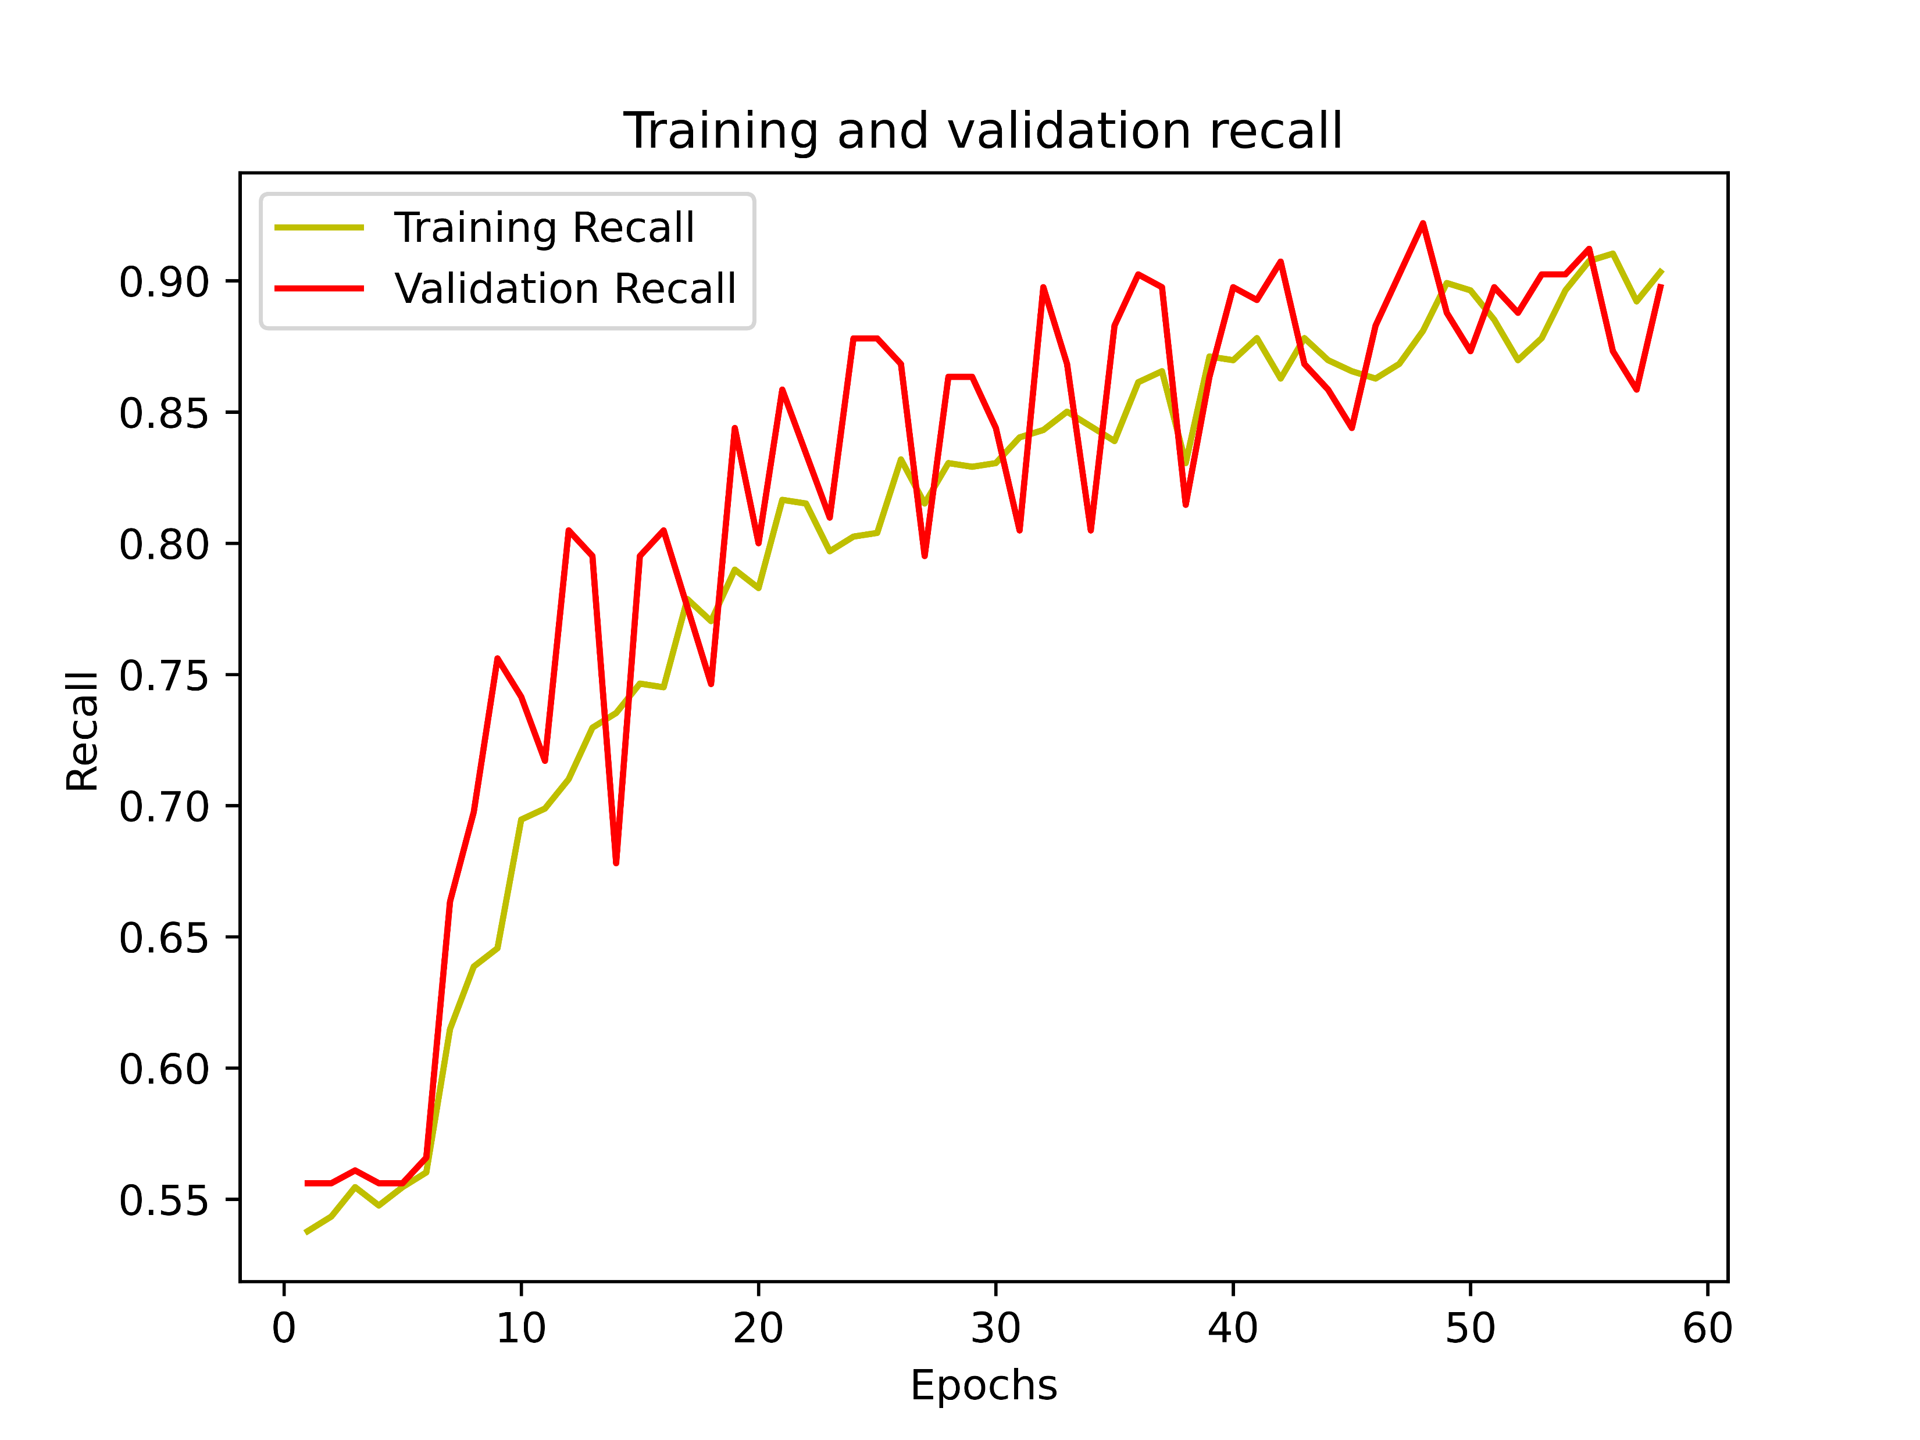
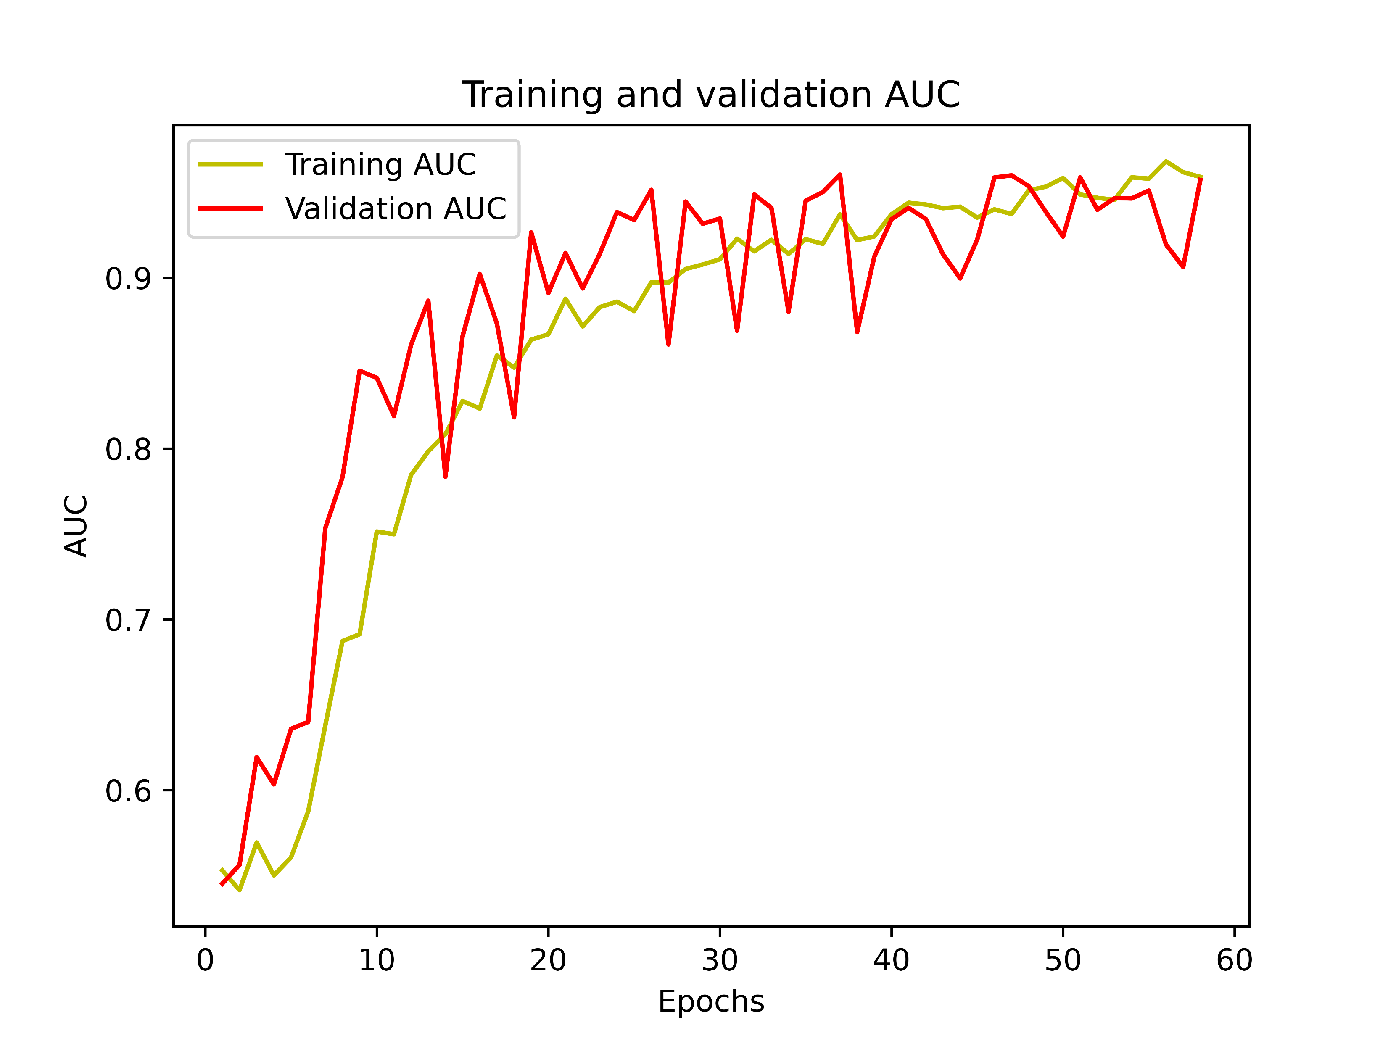
RESULT ANALYSIS
Curves for Dataset-1(Binary Classification) with CNNs:
Figure 9: Various Curves for Binary Classification on Dataset-1

Slide 15
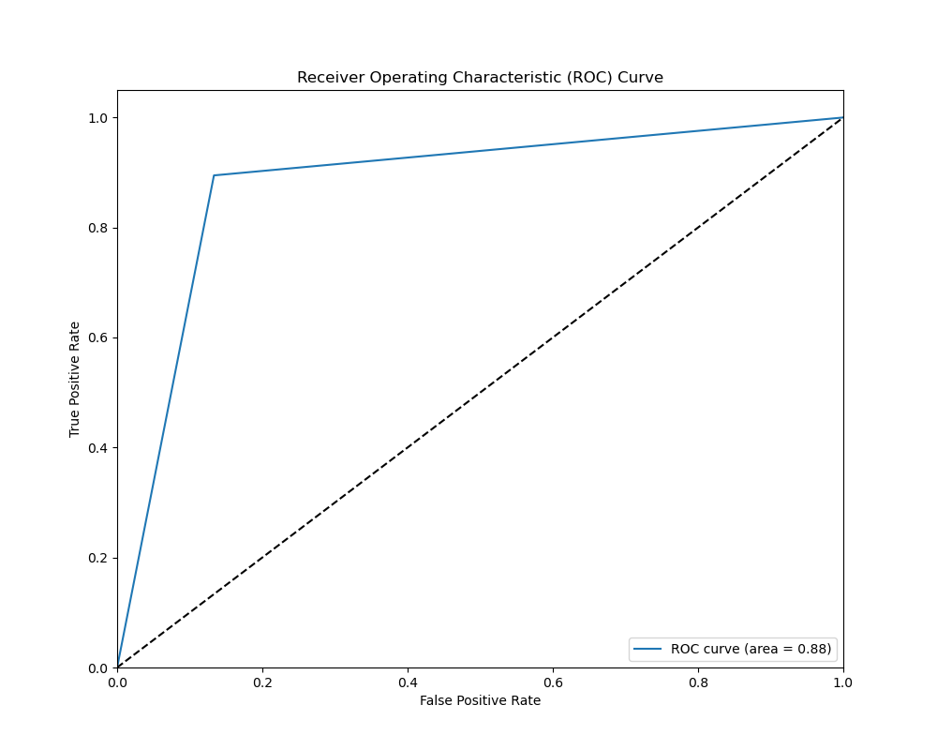
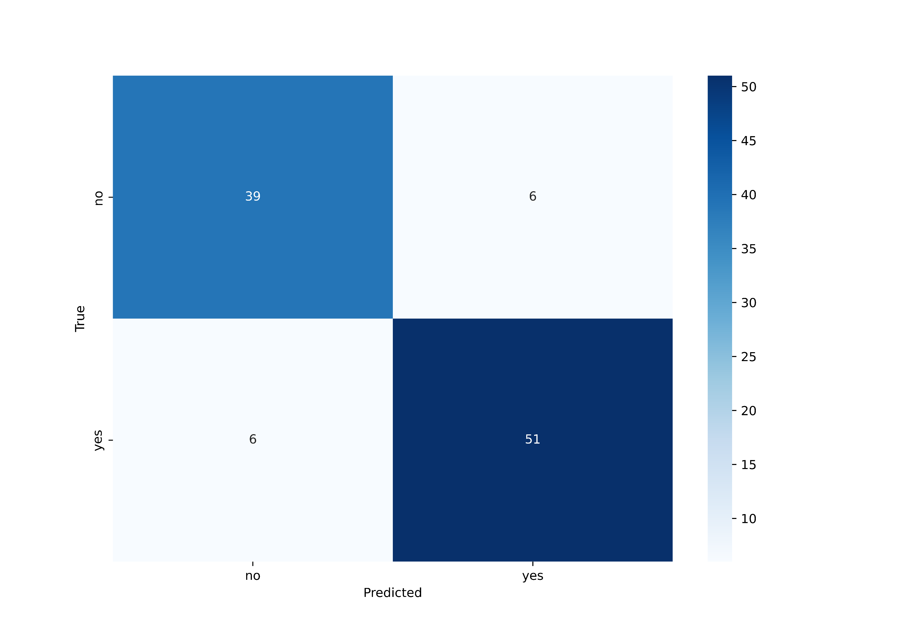
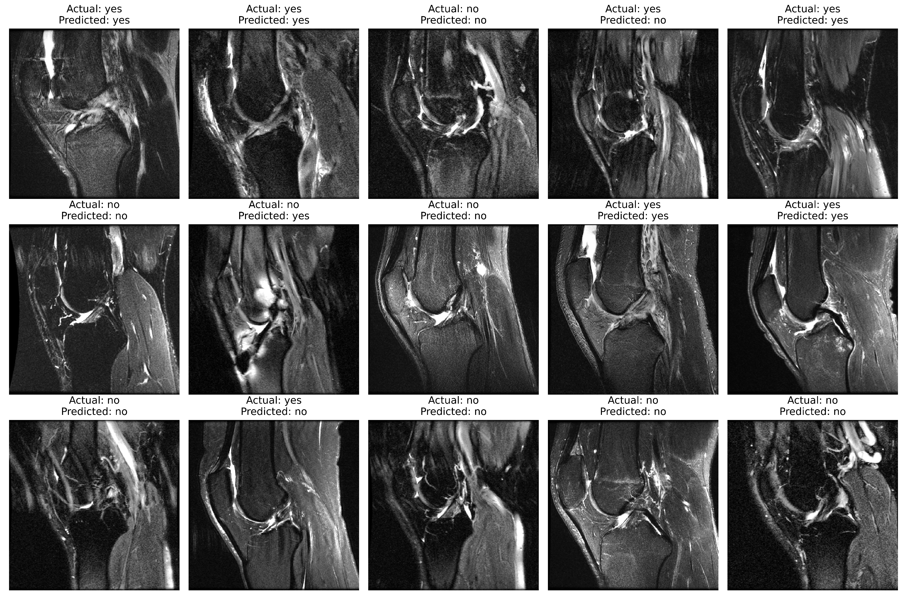
RESULT ANALYSIS(cont’d)
Test Results for Binary Classification on Dataset -1 using CNNs:
Figure 10: Testing Results for Binary Classification on Dataset-1

Slide 16
RESULT ANALYSIS(cont’d)
Classification Report for Binary Classification on Dataset -1 using CNNs:
Table 4: Test Accuracy Scores for Binary Classification
Metric | Precisoin | Recall | F1-Score | Support
Normal | 0.87 | 0.87 | 0.87 | 45
ACL | 0.89 | 0.89 | 0.89 | 57
Accuracy | 0.88 |  |  | 102
Macro avg | 0.88 | 0.88 | 0.88 | 102
Weighted avg | 0.88 | 0.88 | 0.88 | 102

Slide 17
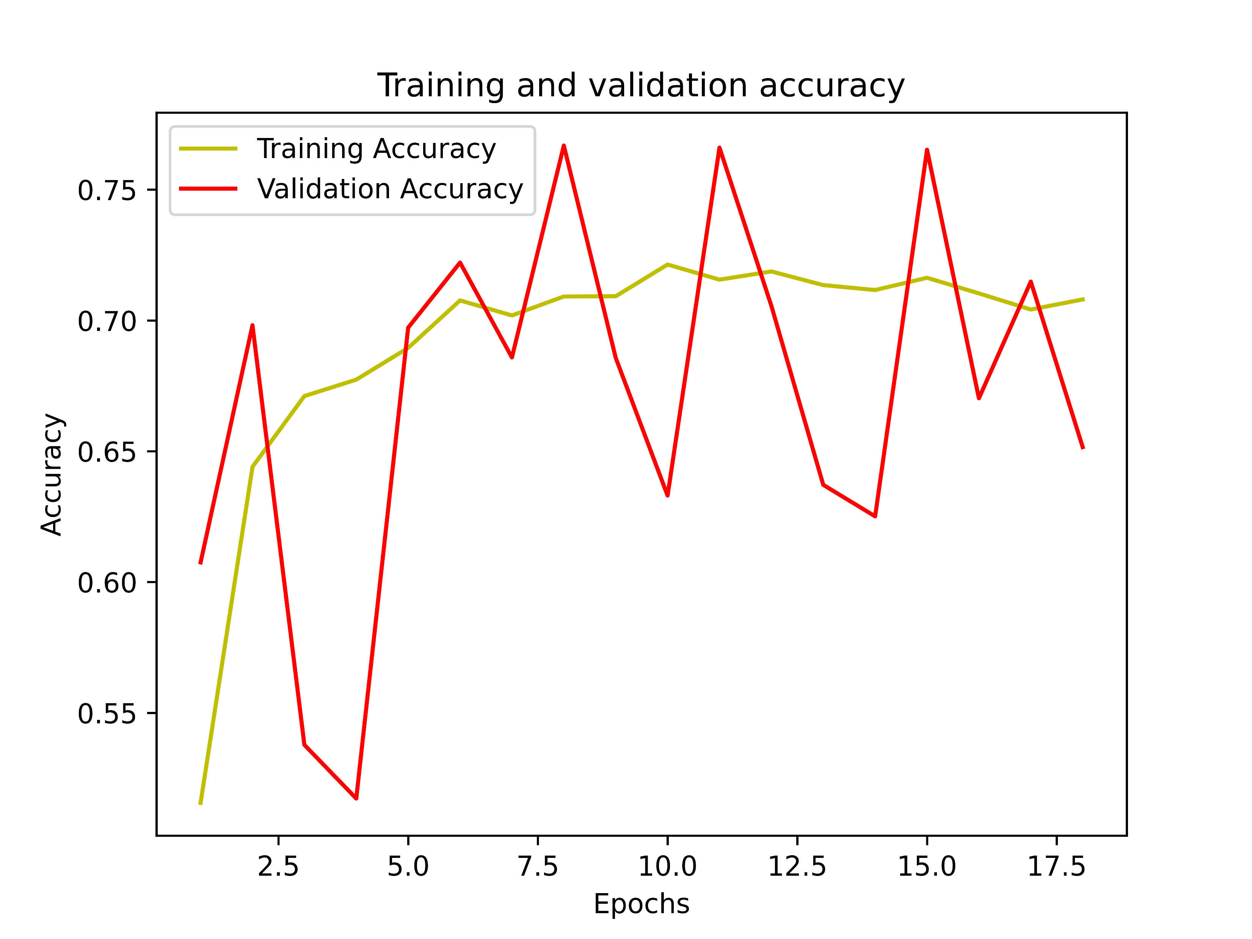
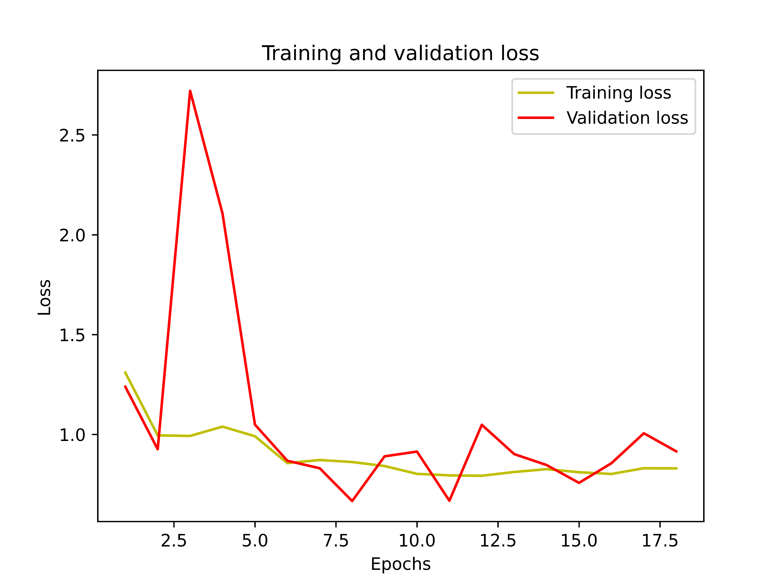
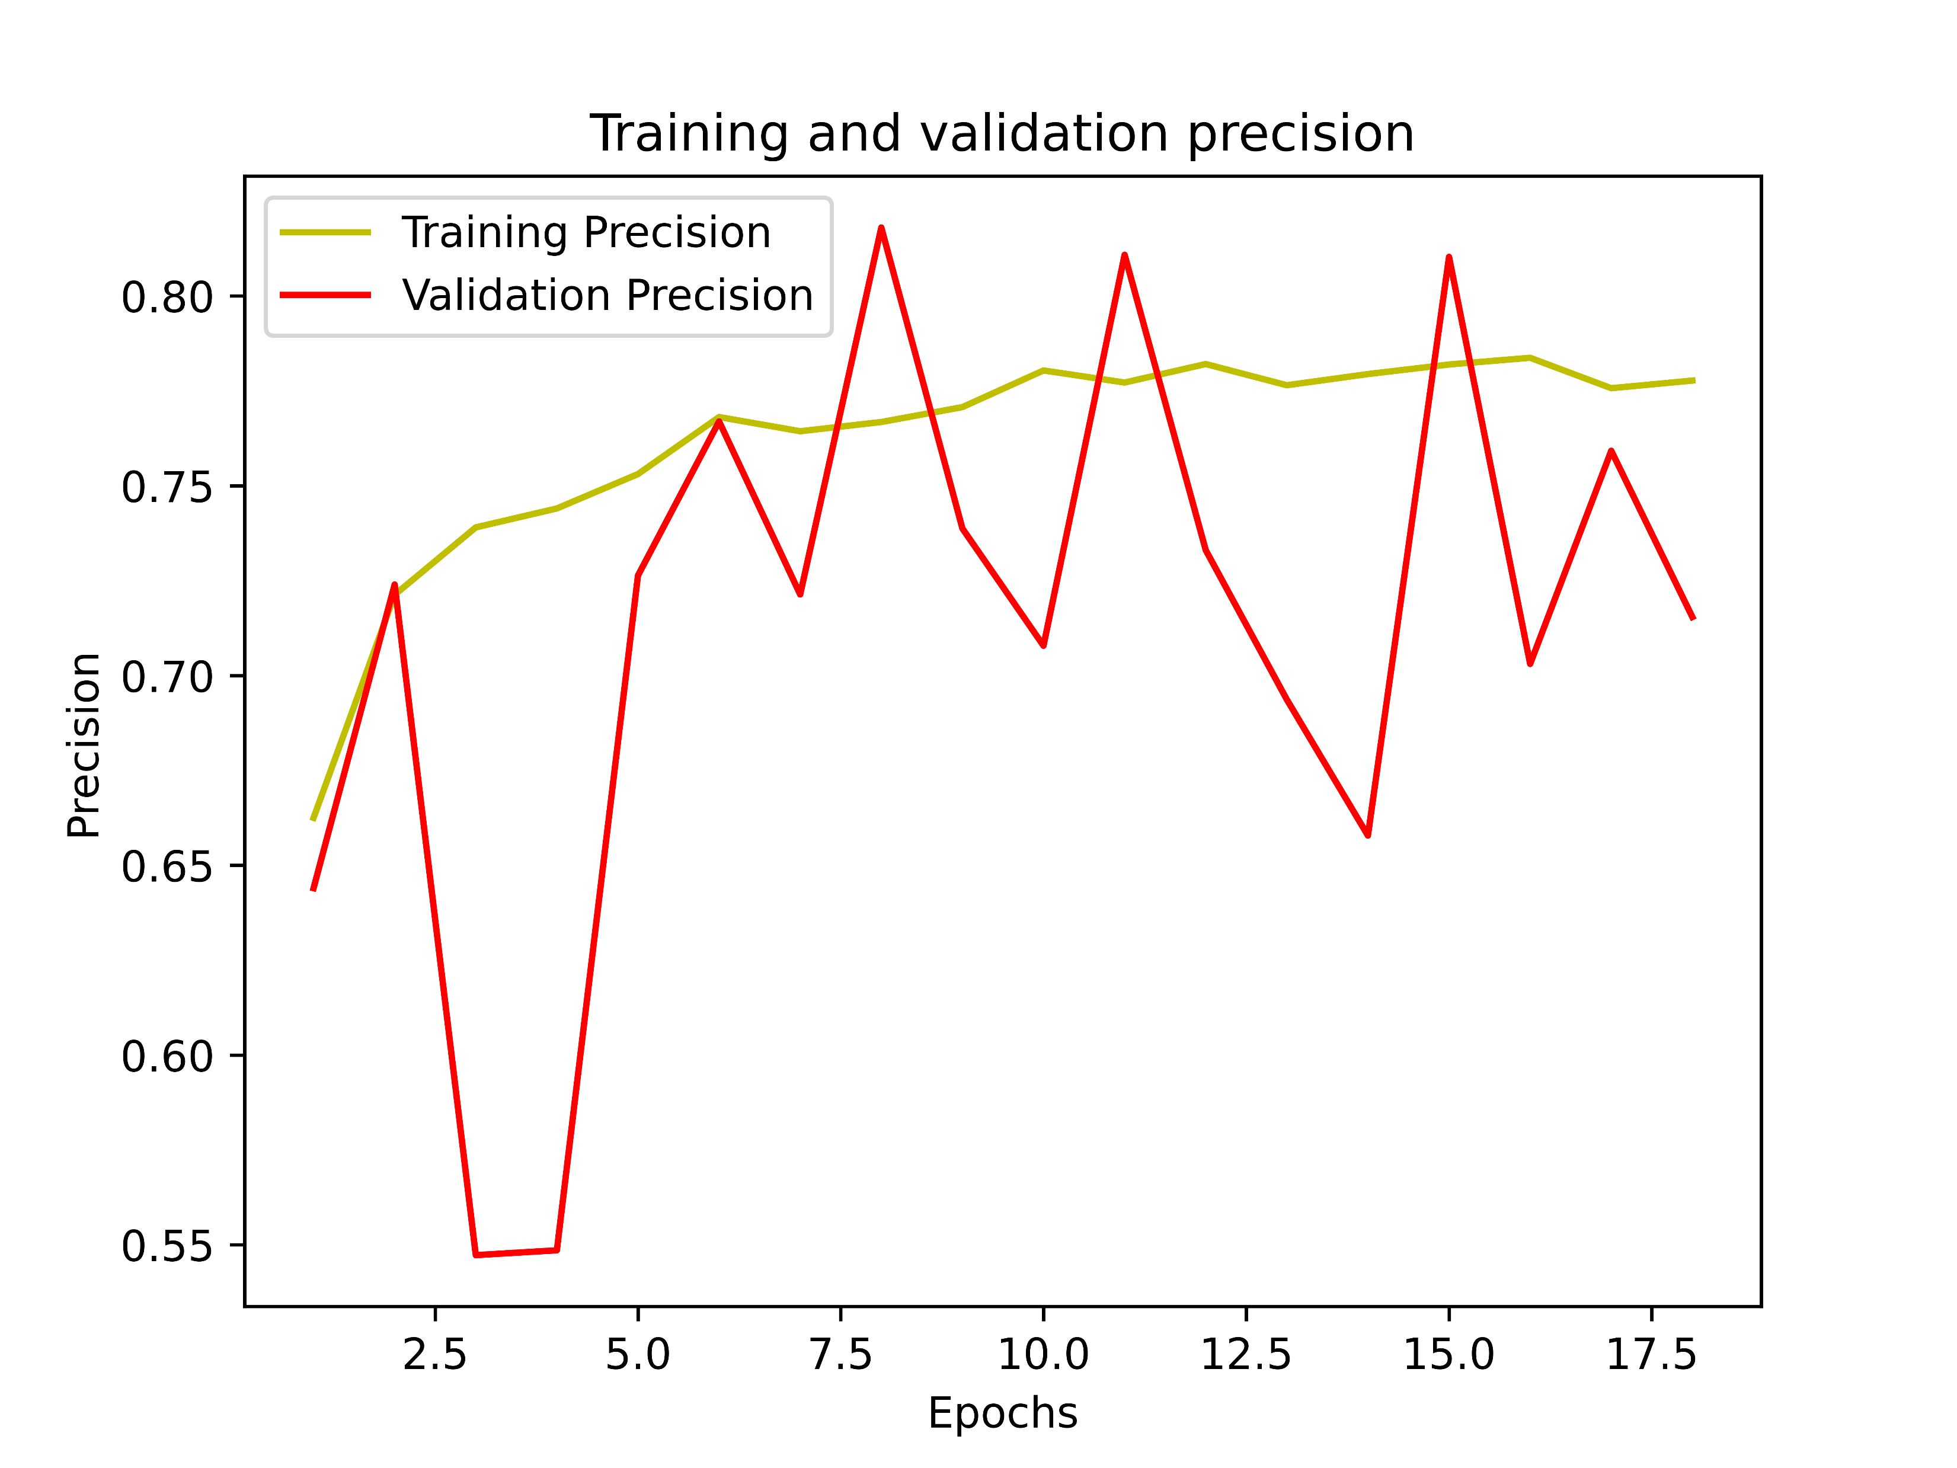
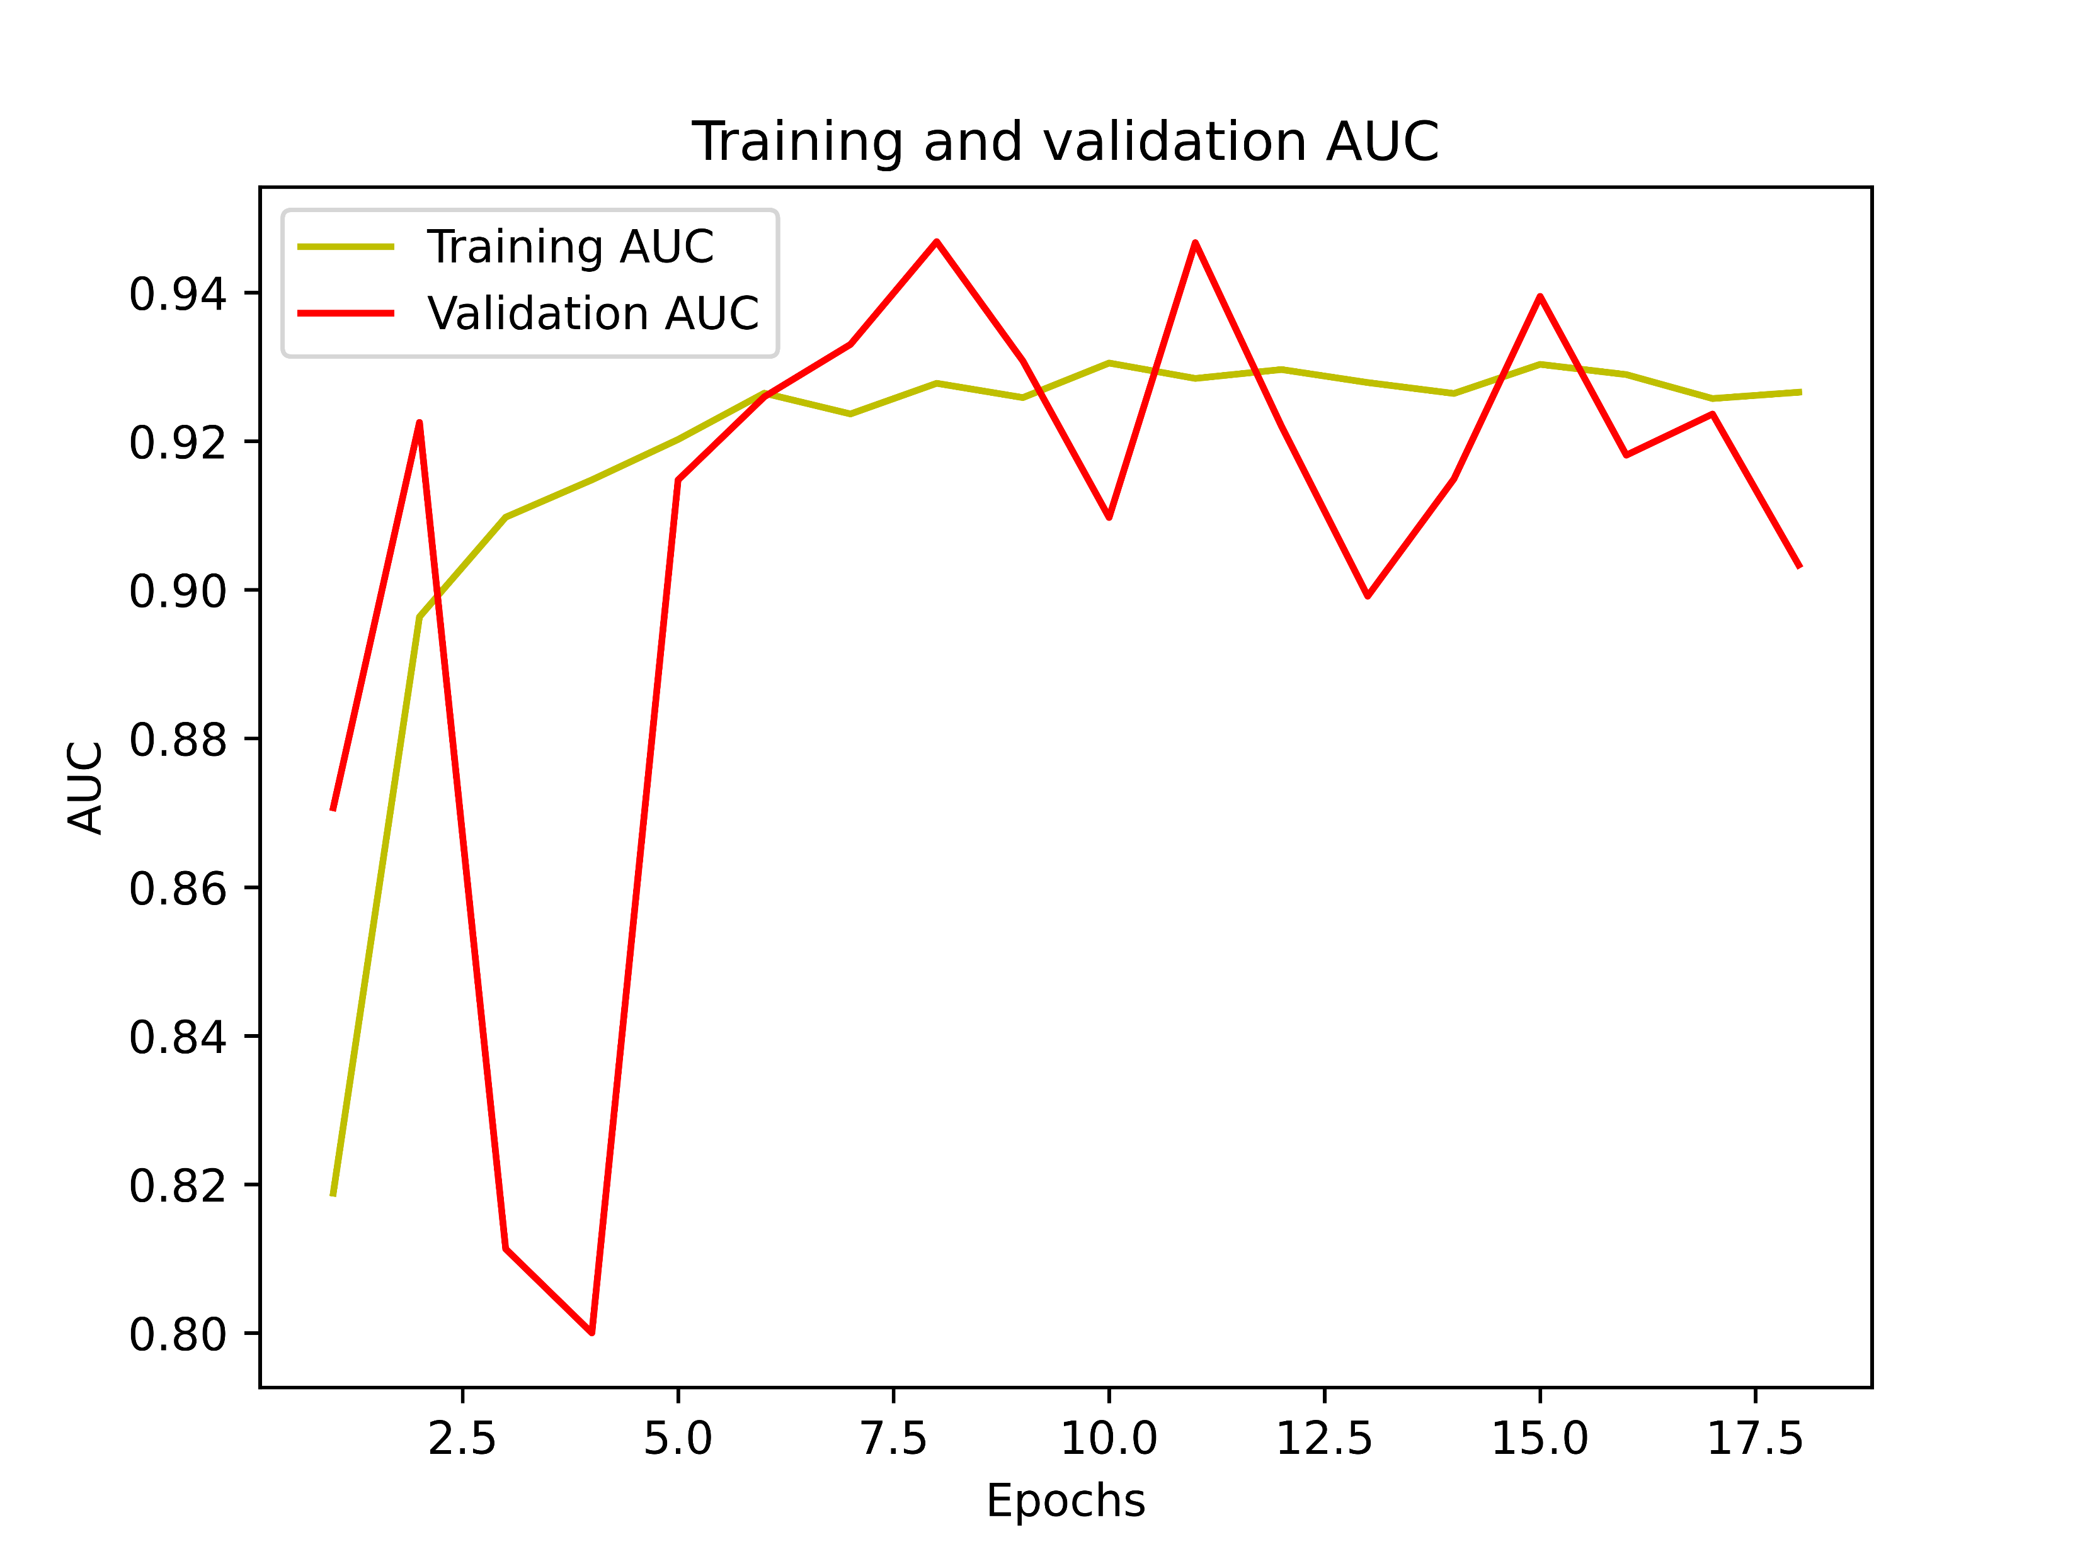
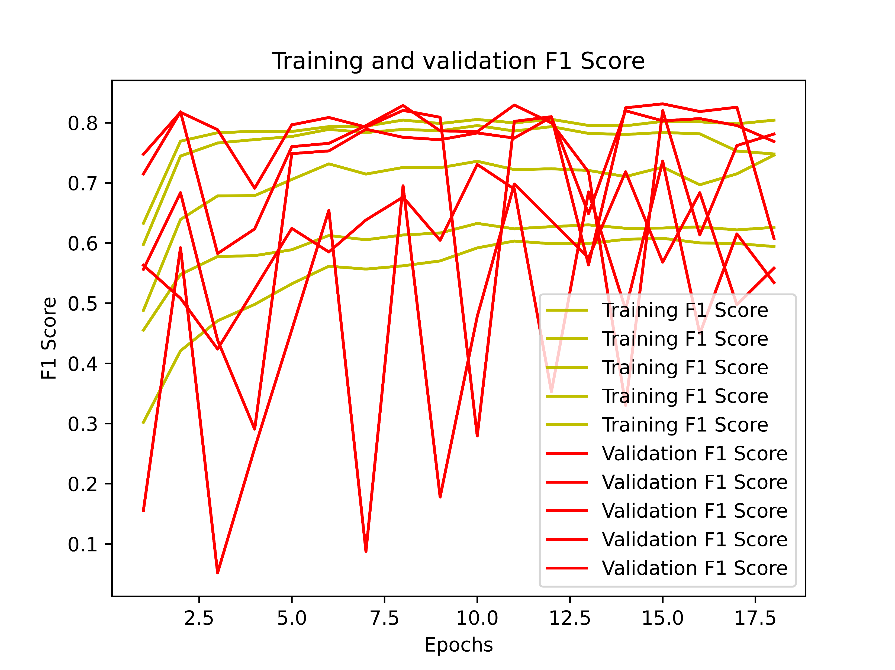
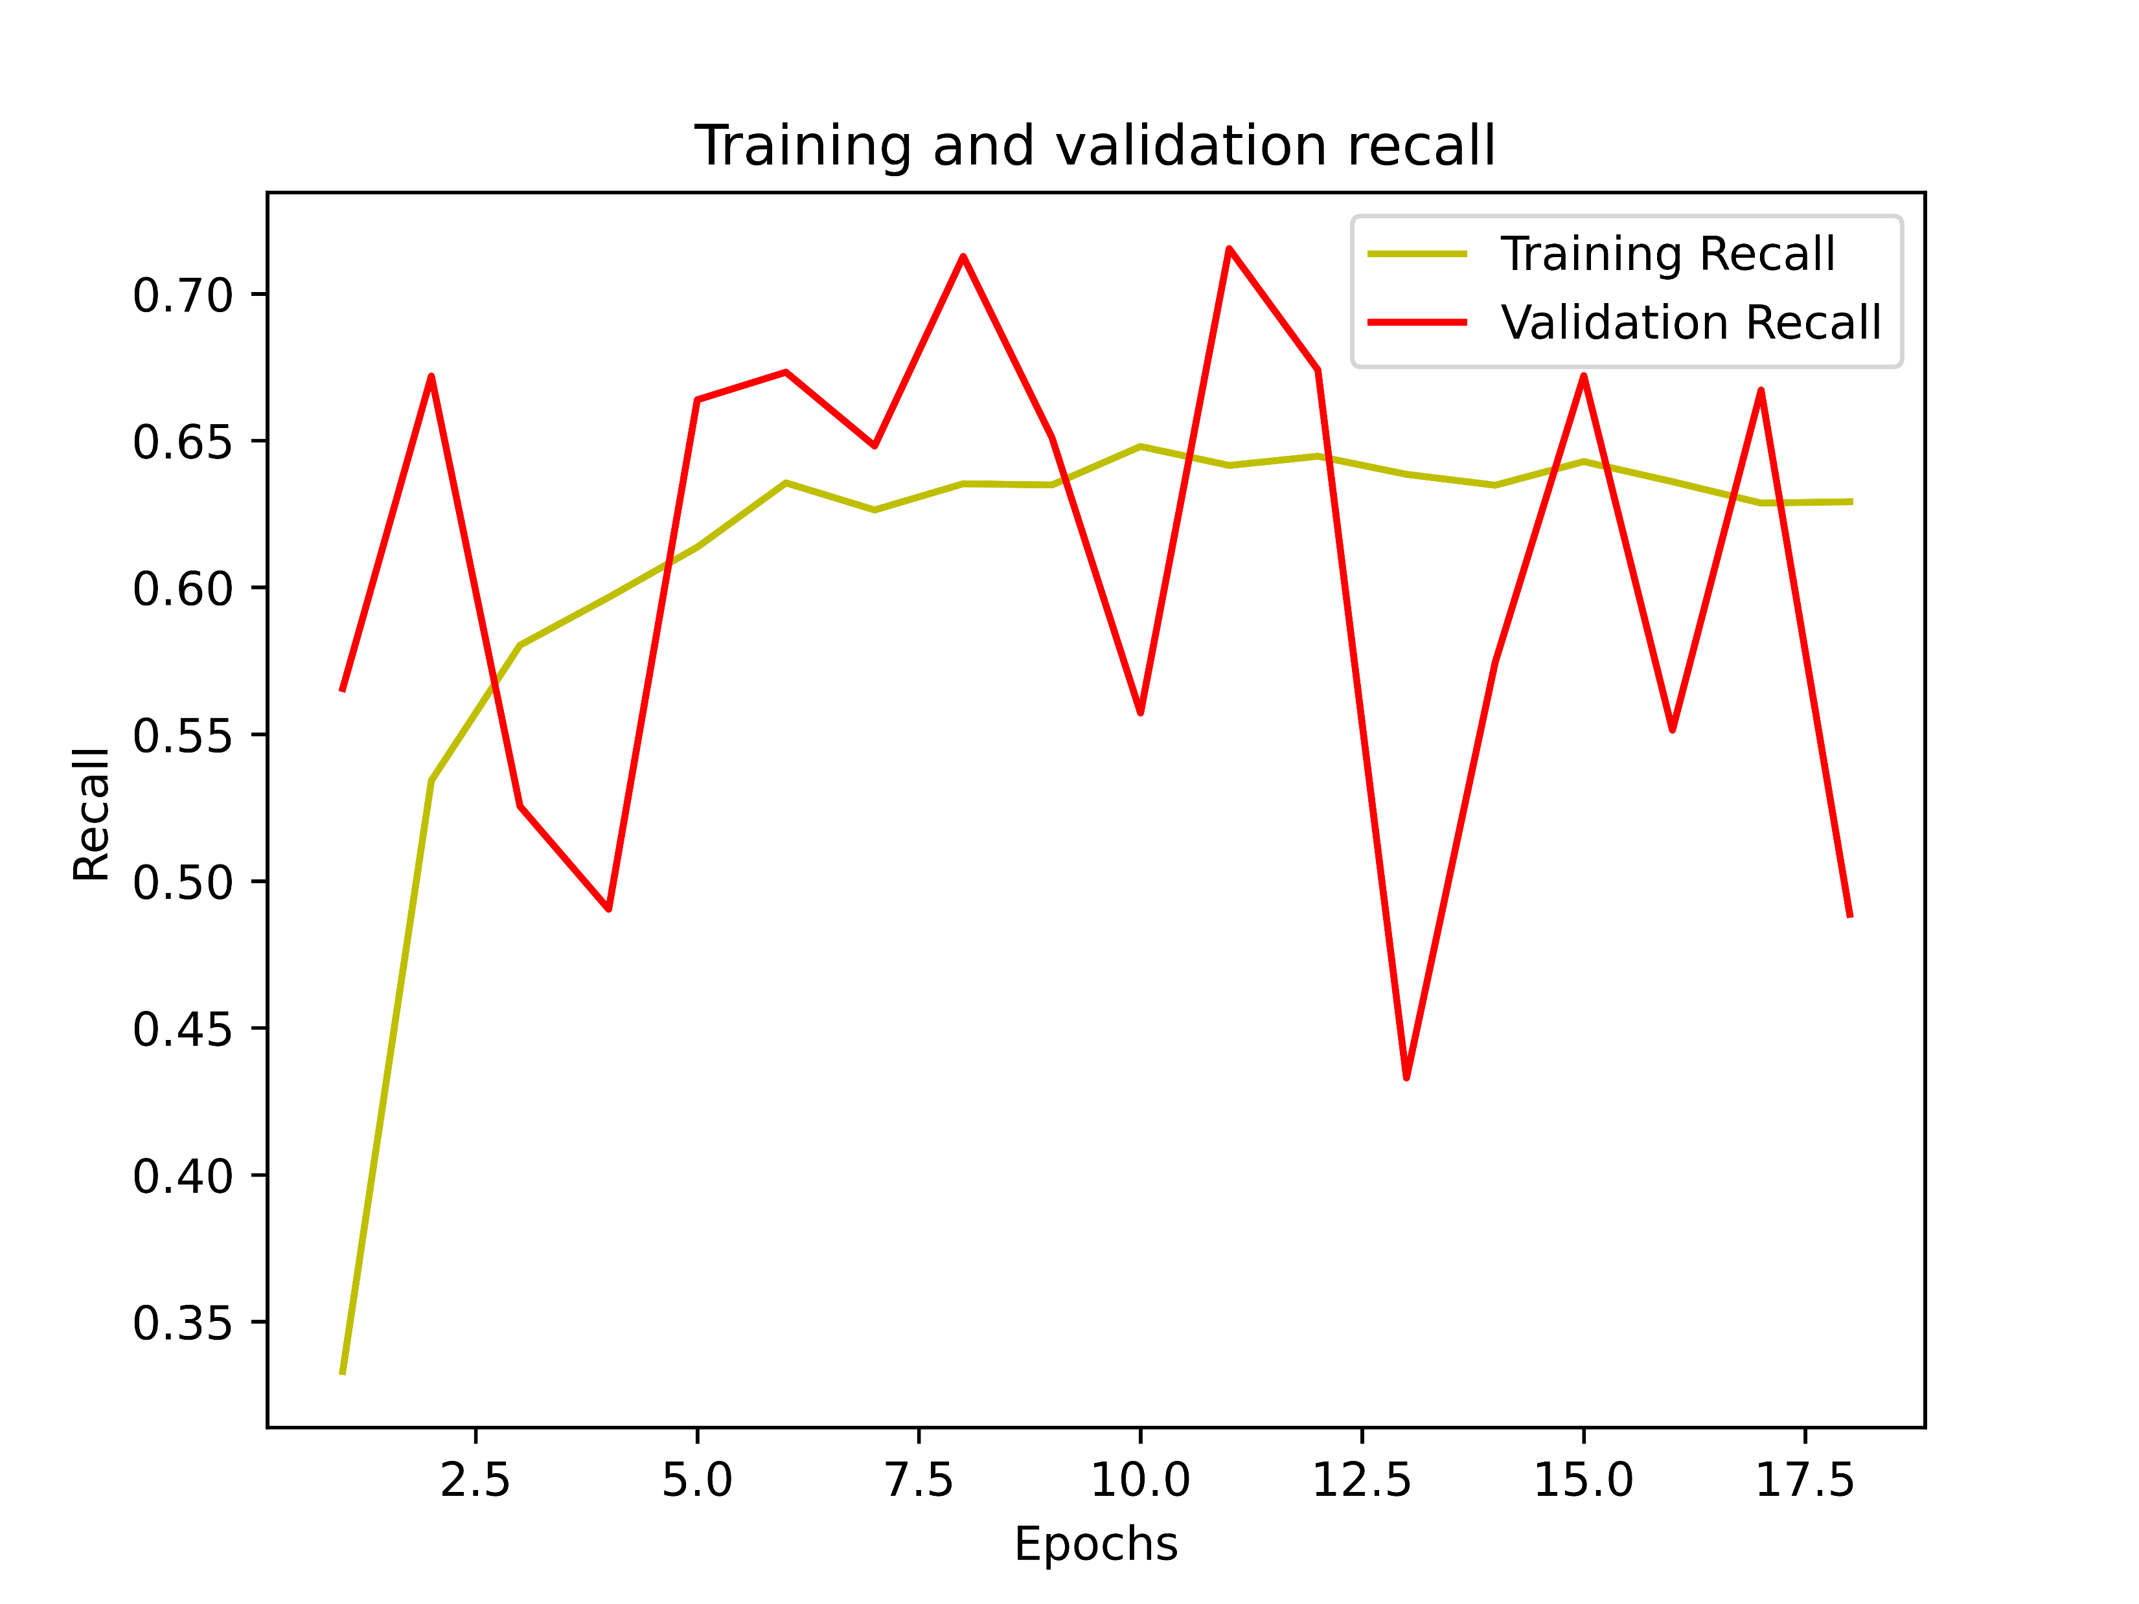
RESULT ANALYSIS
Curves for Dataset-2(Multi-Class Classification) with CNNs:
Figure 11: Various Curves for Multi-Class Classification on Dataset-2

Slide 18
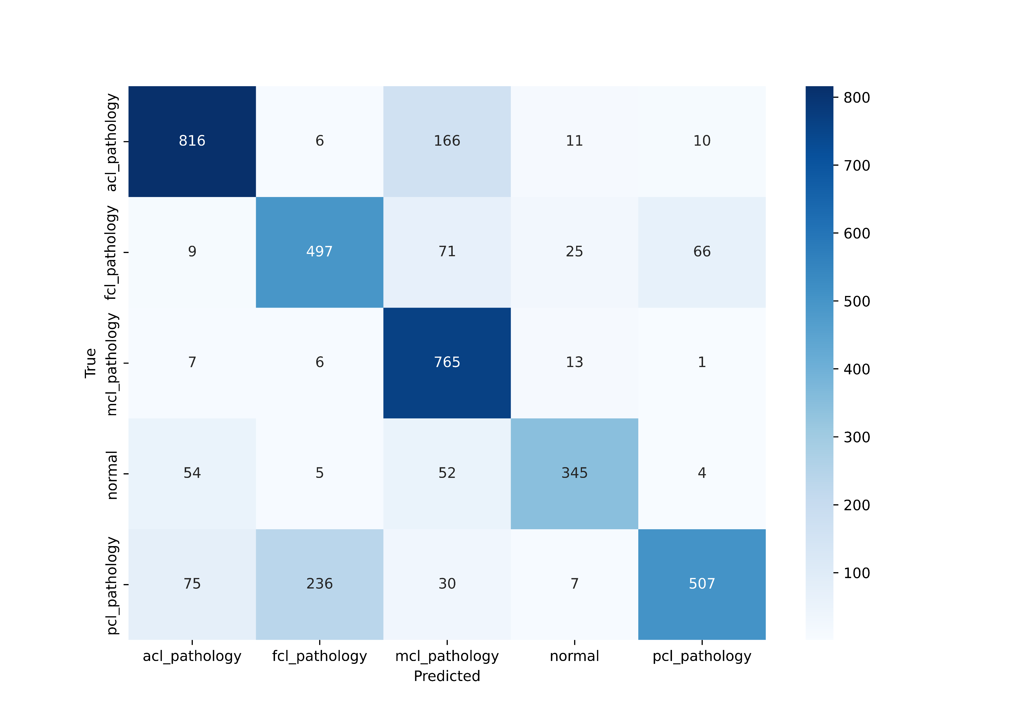
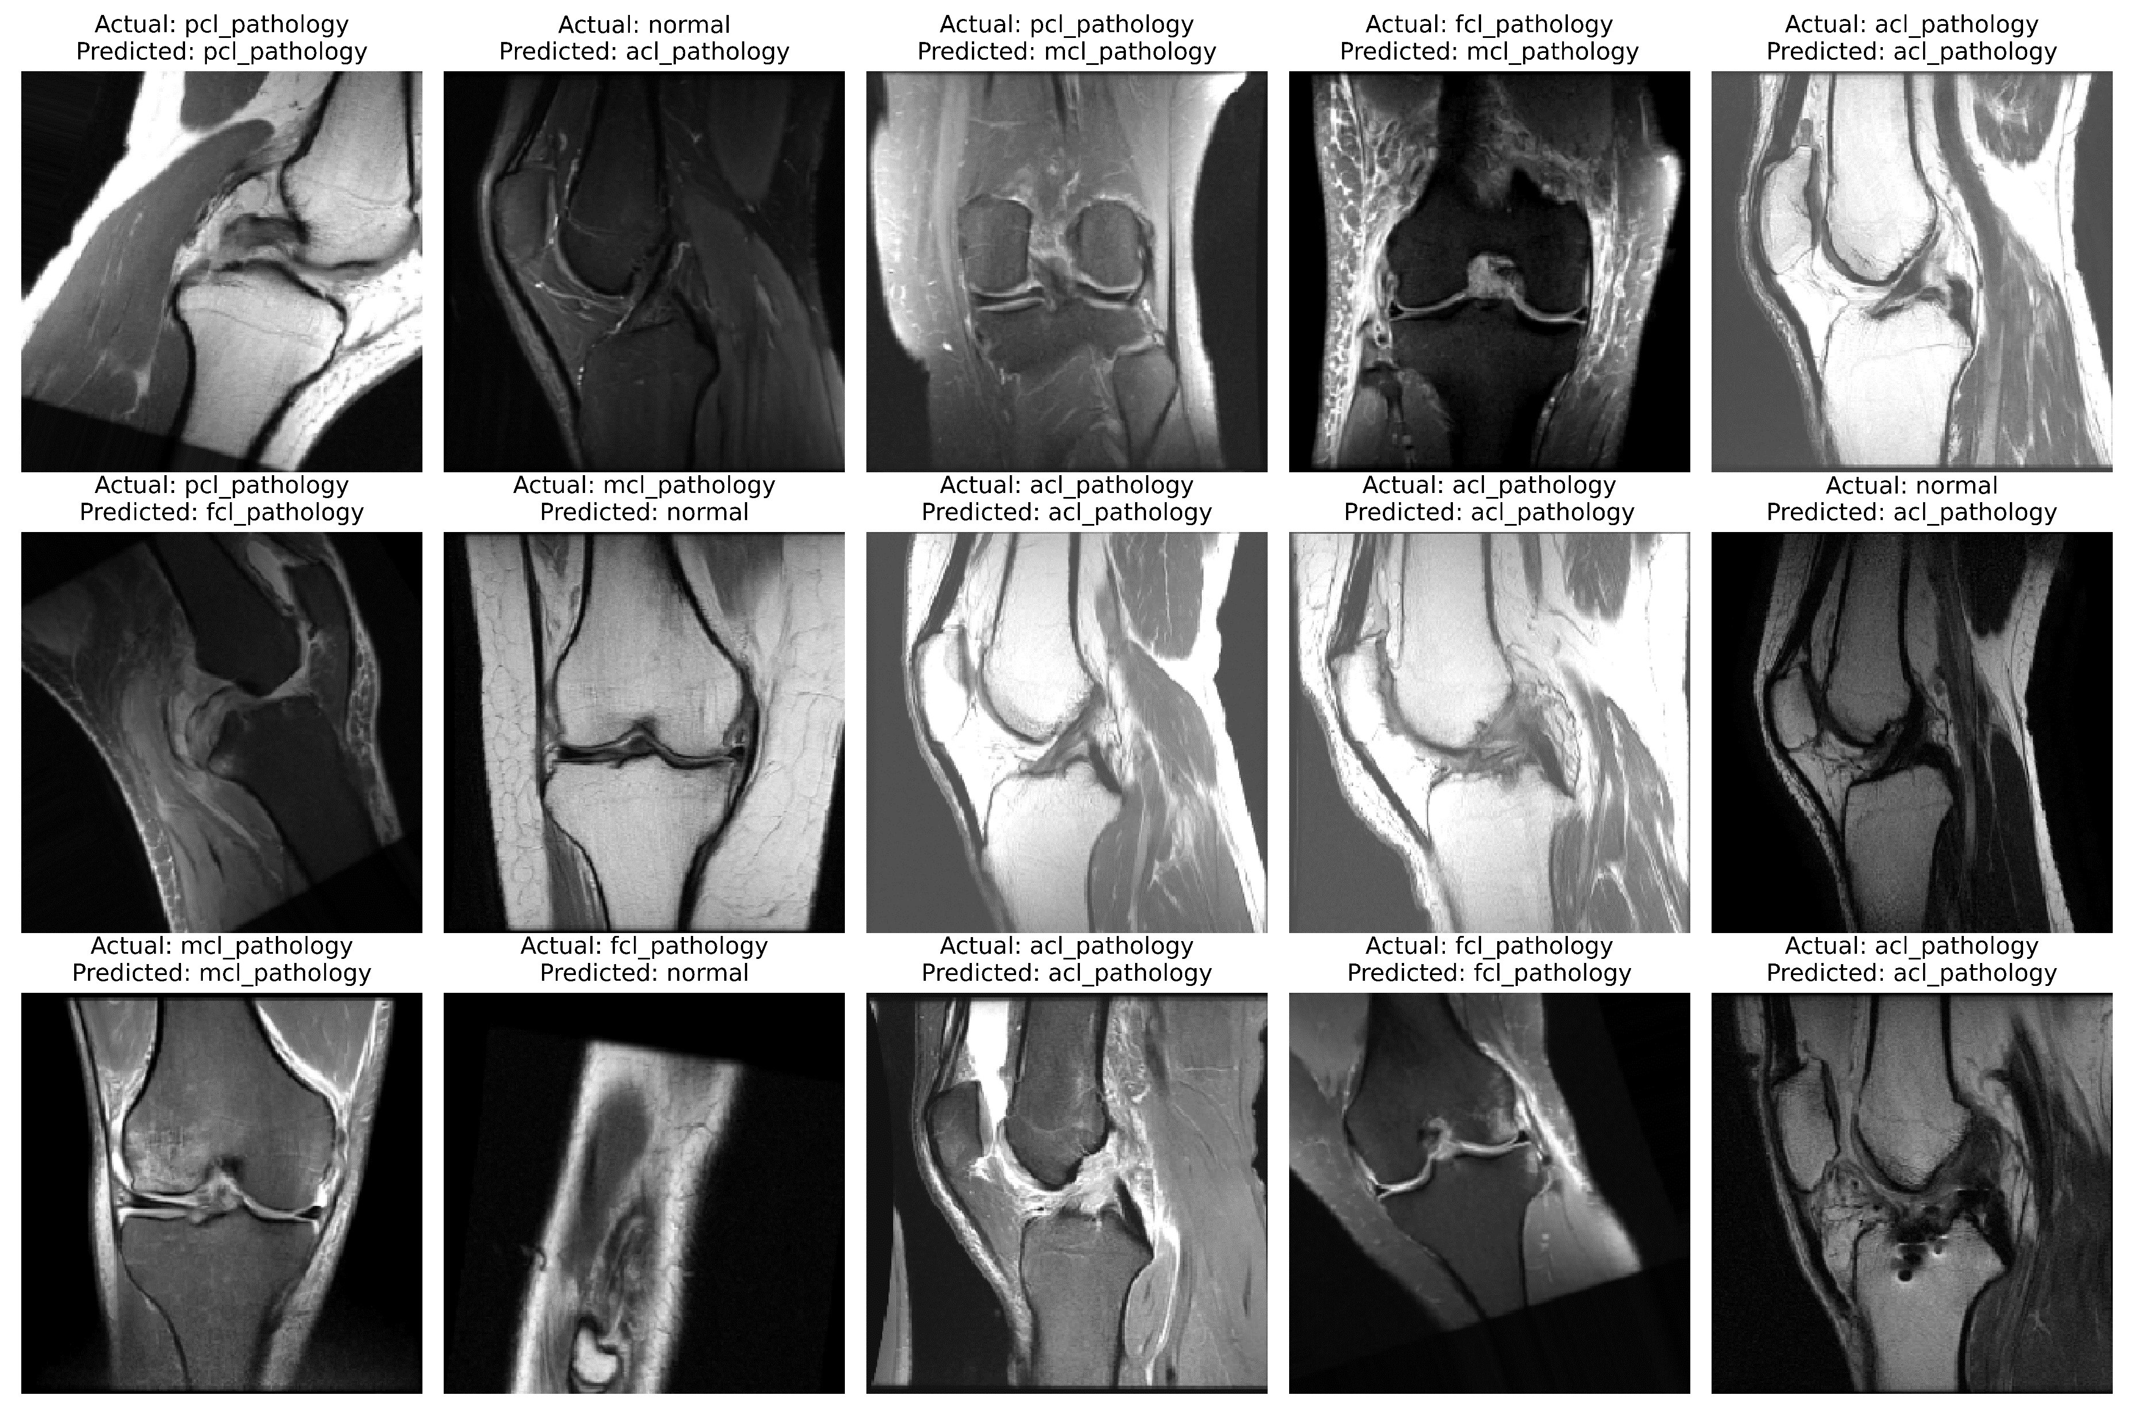
RESULT ANALYSIS(cont’d)
Test Results for Multi-Class Classification on Dataset -2 using CNNs:
Figure 12: Testing Results for Multi-Class Classification on Dataset-2

Slide 19
RESULT ANALYSIS(cont’d)
Classification Report for Multi-Class Classification on Dataset -2 using CNNs:
Table 5: Classification Report for Multi-Class Classification for Dataset -2
Metrics | Precision | Recall | F1-Score | Support
ACL | 0.85 | 0.81 | 0.83 | 1009
FCL | 0.66 | 0.74 | 0.70 | 668
MCL | 0.71 | 0.97 | 0.82 | 792
Normal | 0.86 | 0.75 | 0.80 | 460
PCL | 0.86 | 0.59 | 0.70 | 855
Accuracy | 0.77 |  |  | 3784
Macro avg | 0.79 | 0.77 | 0.77 | 3784
Weighted avg | 0.79 | 0.77 | 0.77 | 3784

Slide 20
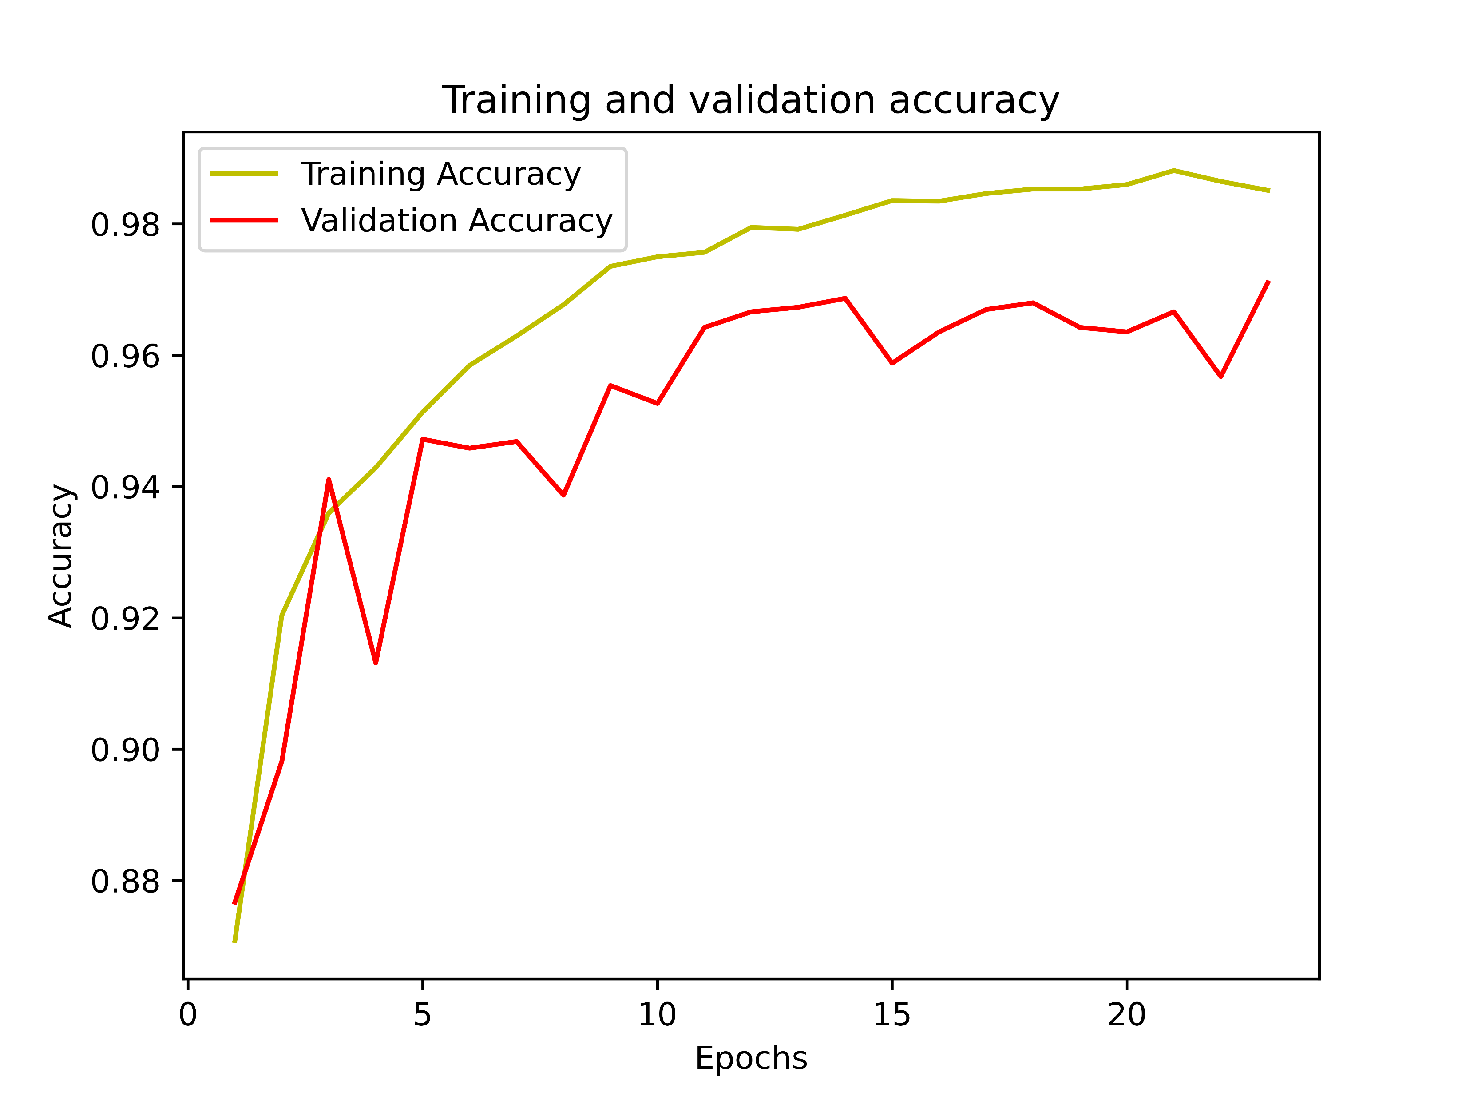
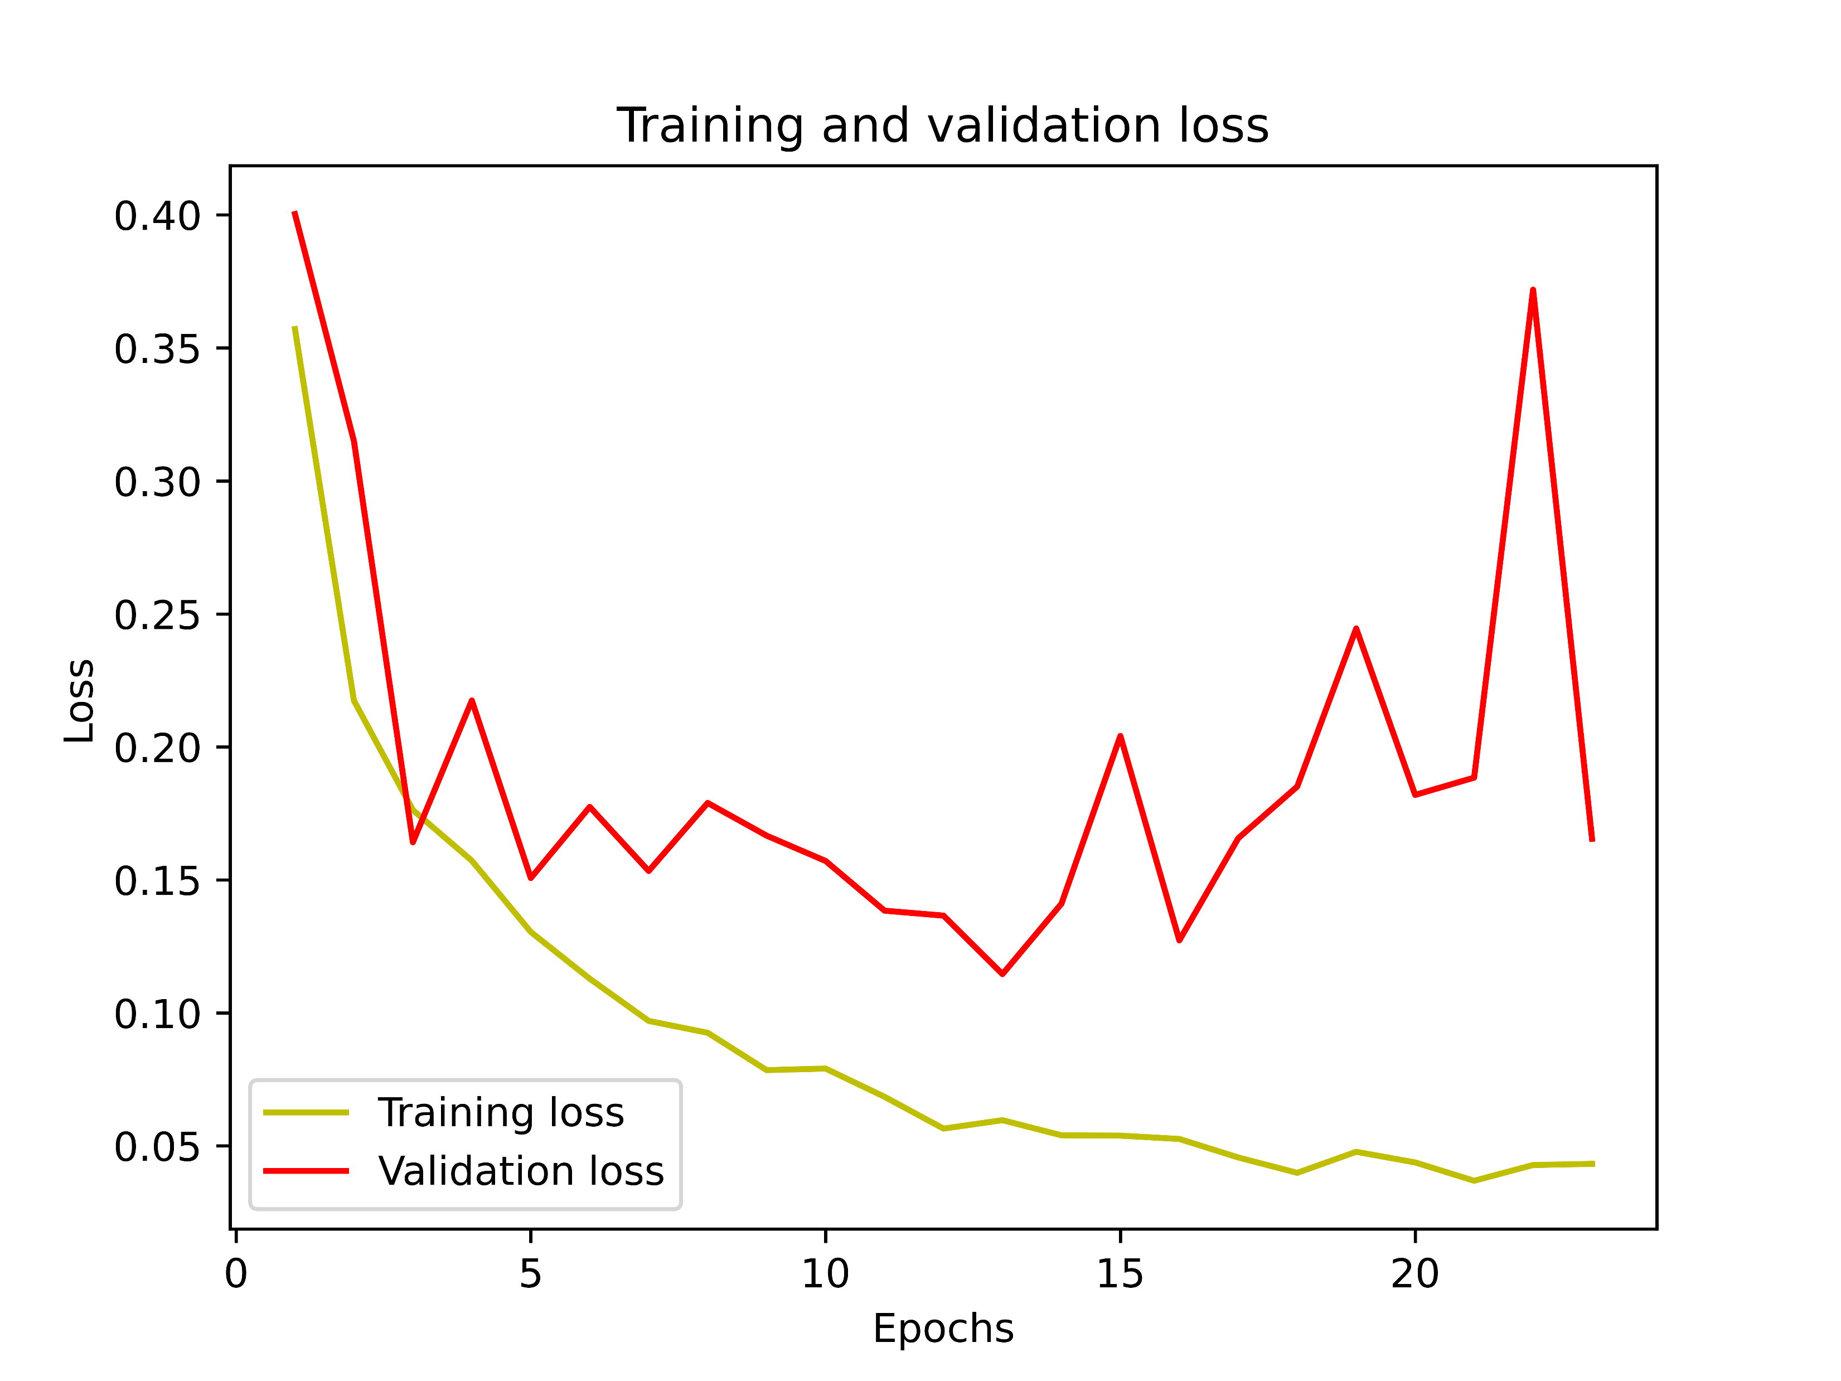
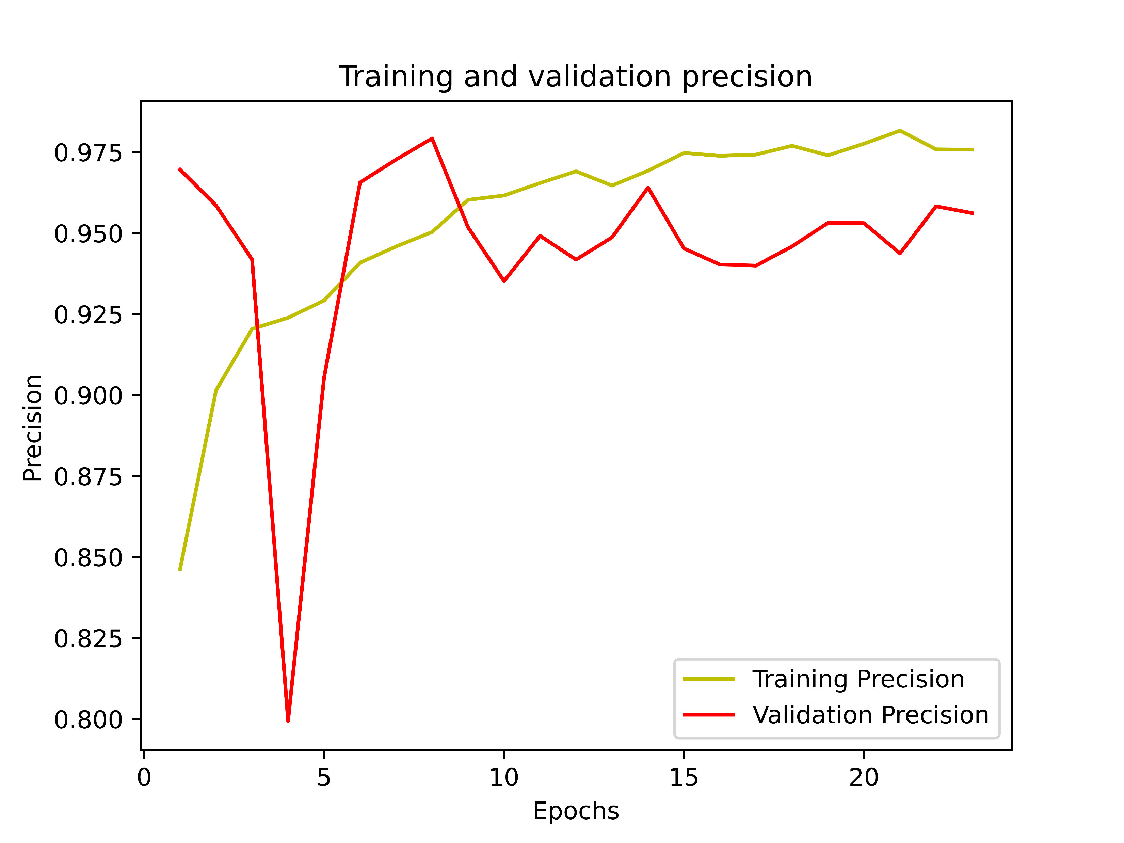
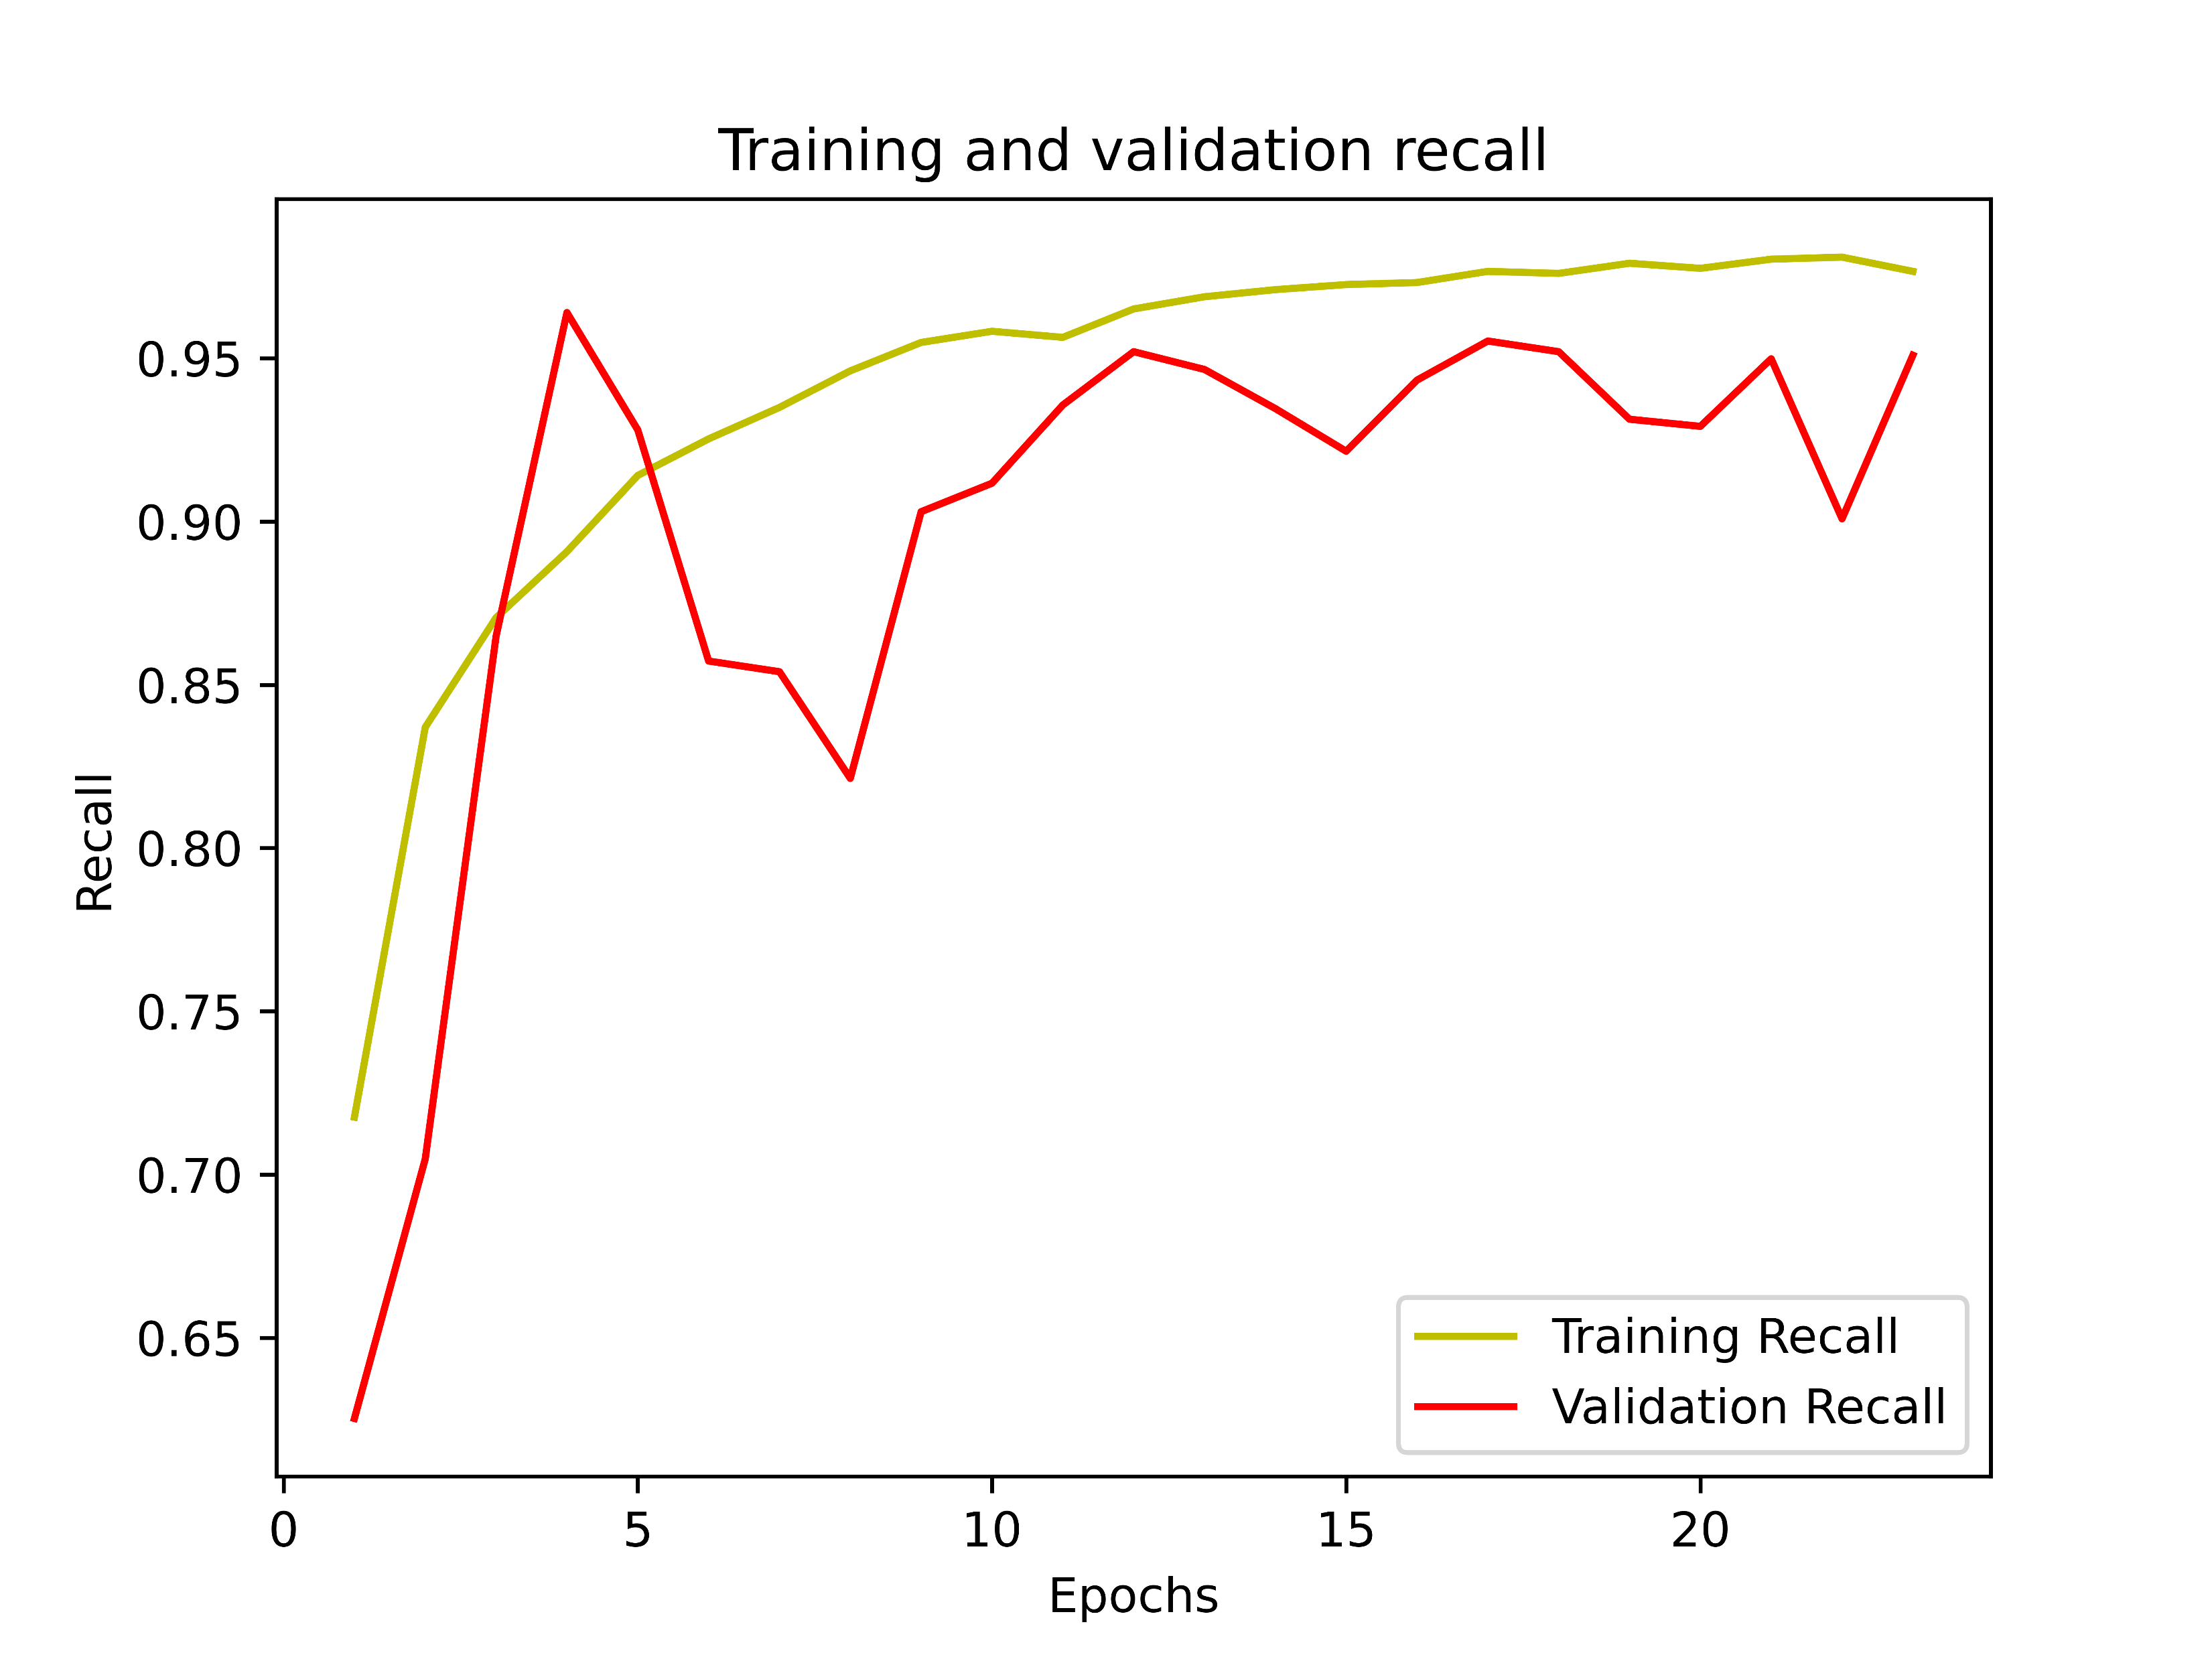
RESULT ANALYSIS(cont’d)
Curves for Dataset-1 (Binary Classification) with Attention Architecture :
Figure 13: Various Curves and Results for Binary Classification on Dataset-1

Slide 21
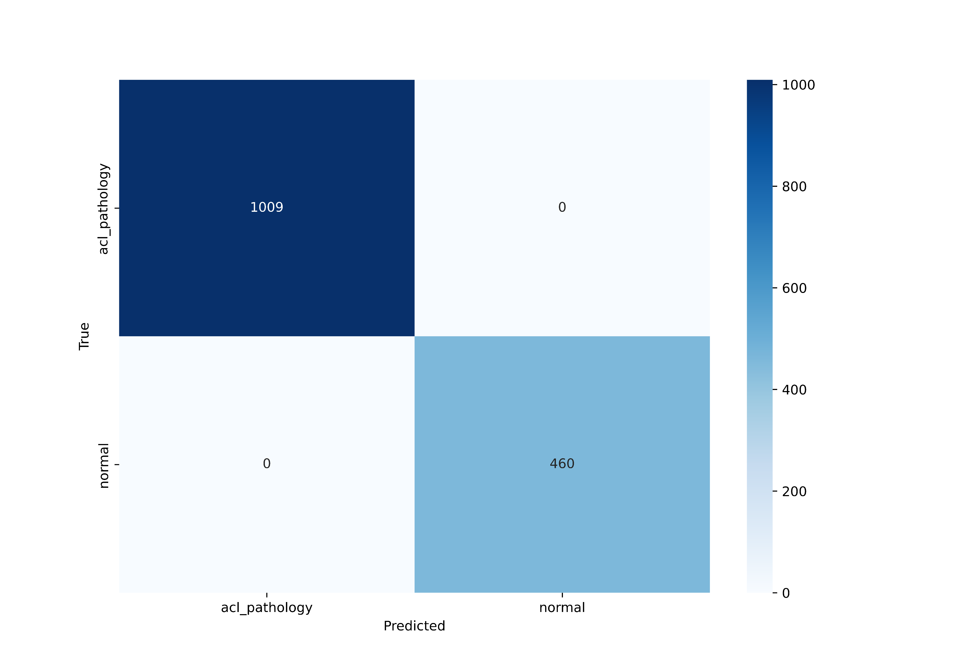
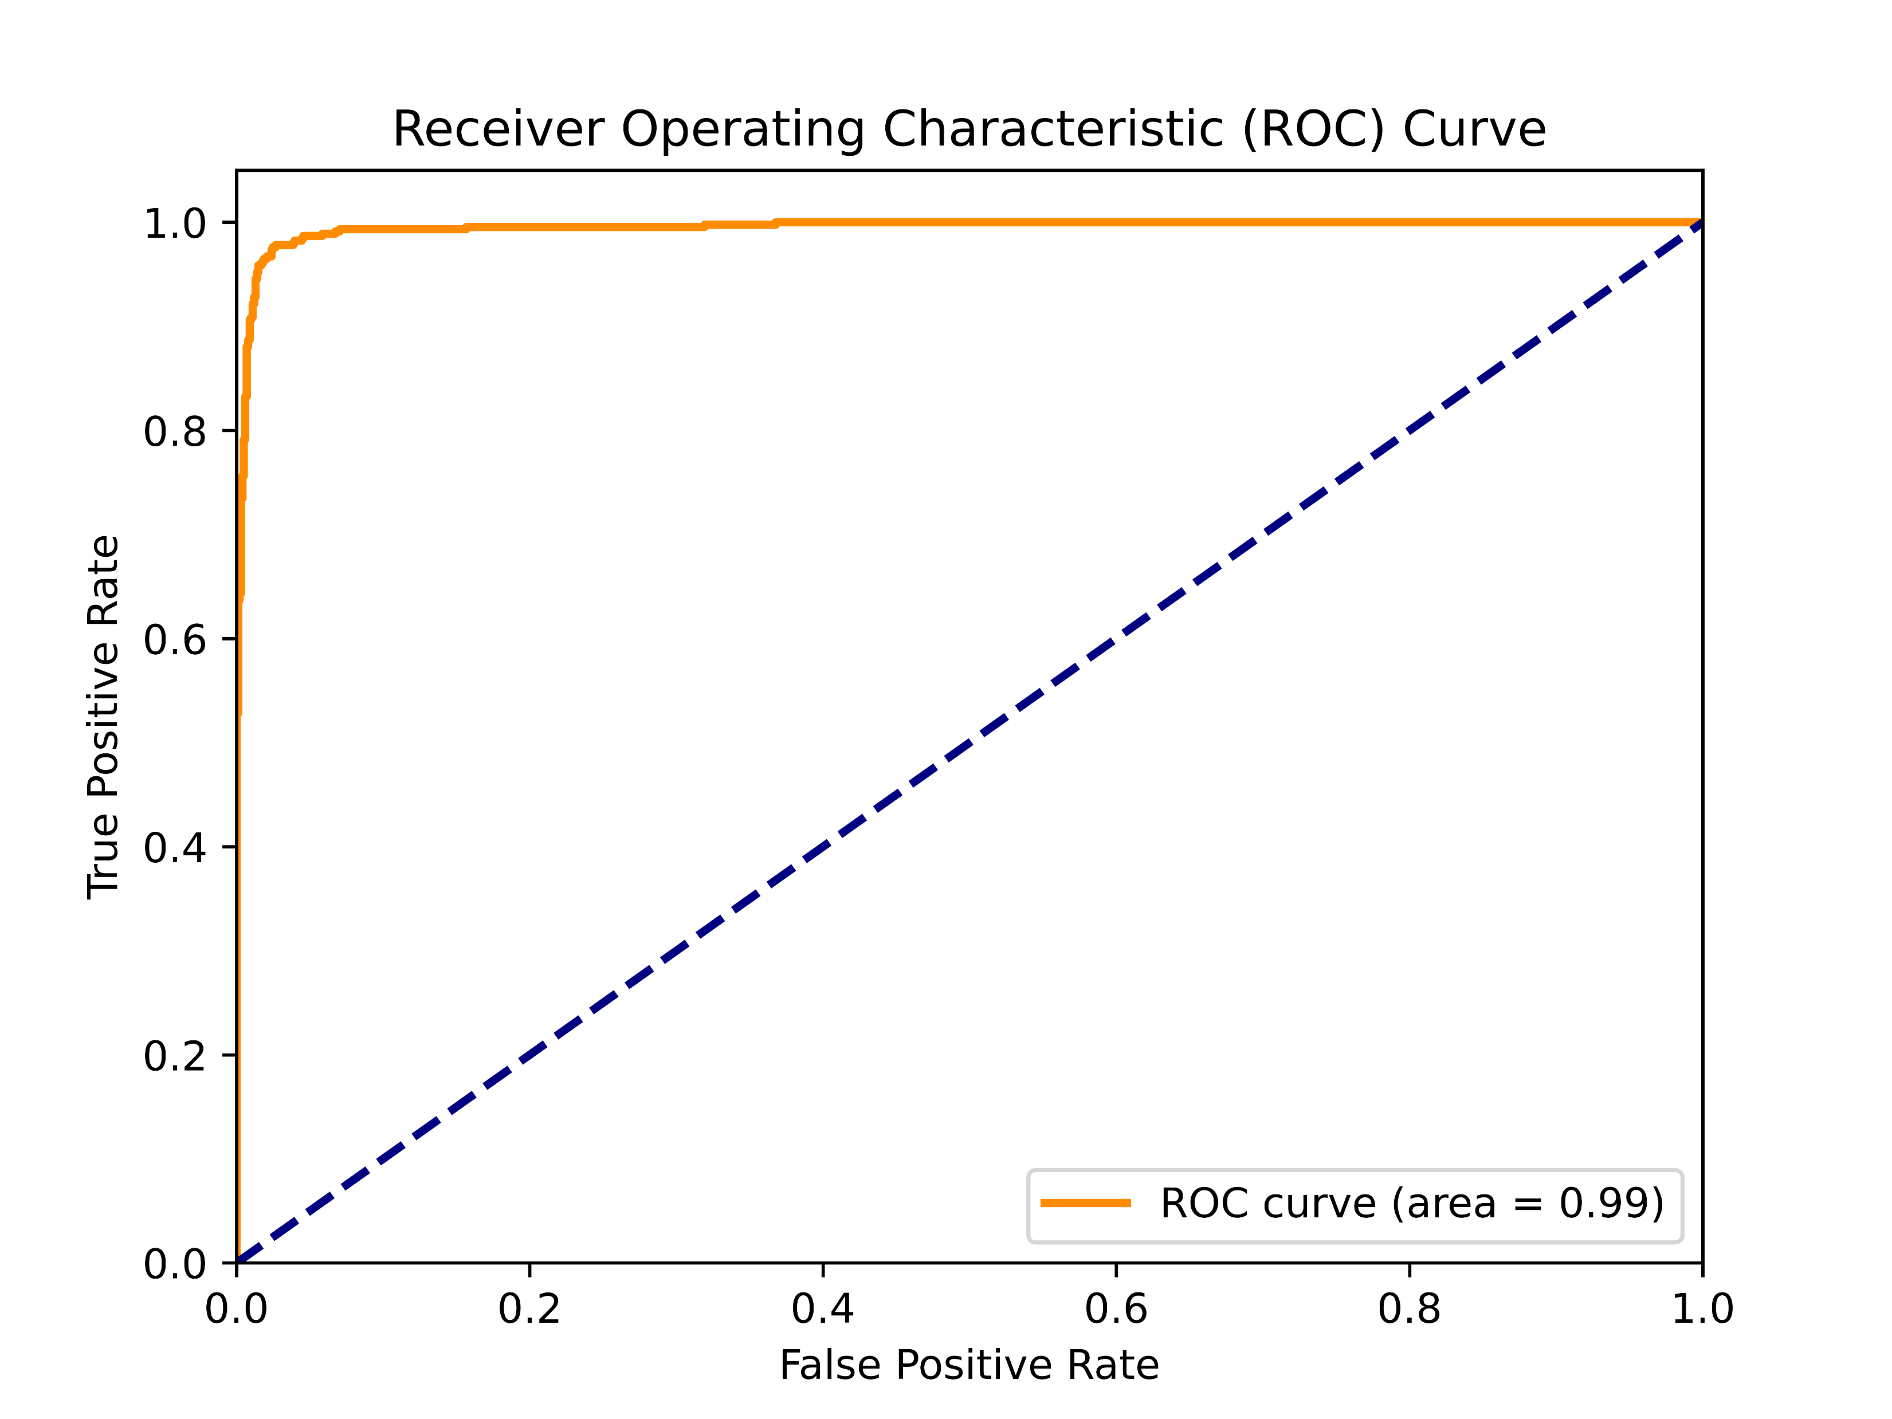
RESULT ANALYSIS(cont’d)
Test results for Dataset-1 (Binary Classification) with Attention Architecture :
Figure 14: Testing Results for Binary Classification on Dataset-1

Slide 22
RESULT ANALYSIS(cont’d)
Classification Report for Binary Classification on Dataset -1 using Attention Architecture:
Table 6: Test Accuracy Scores for Binary Classification(Dataset-1)
Metric | Precisoin | Recall | F1-Score | Support
ACL | 1.00 | 1.00 | 1.00 | 1009
Normal | 1.00 | 1.00 | 1.00 | 460
Accuracy | 1.00 |  |  | 1469
Macro avg | 1.00 | 1.00 | 1.00 | 1469
Weighted avg | 1.00 | 1.00 | 1.00 | 1469

Slide 23
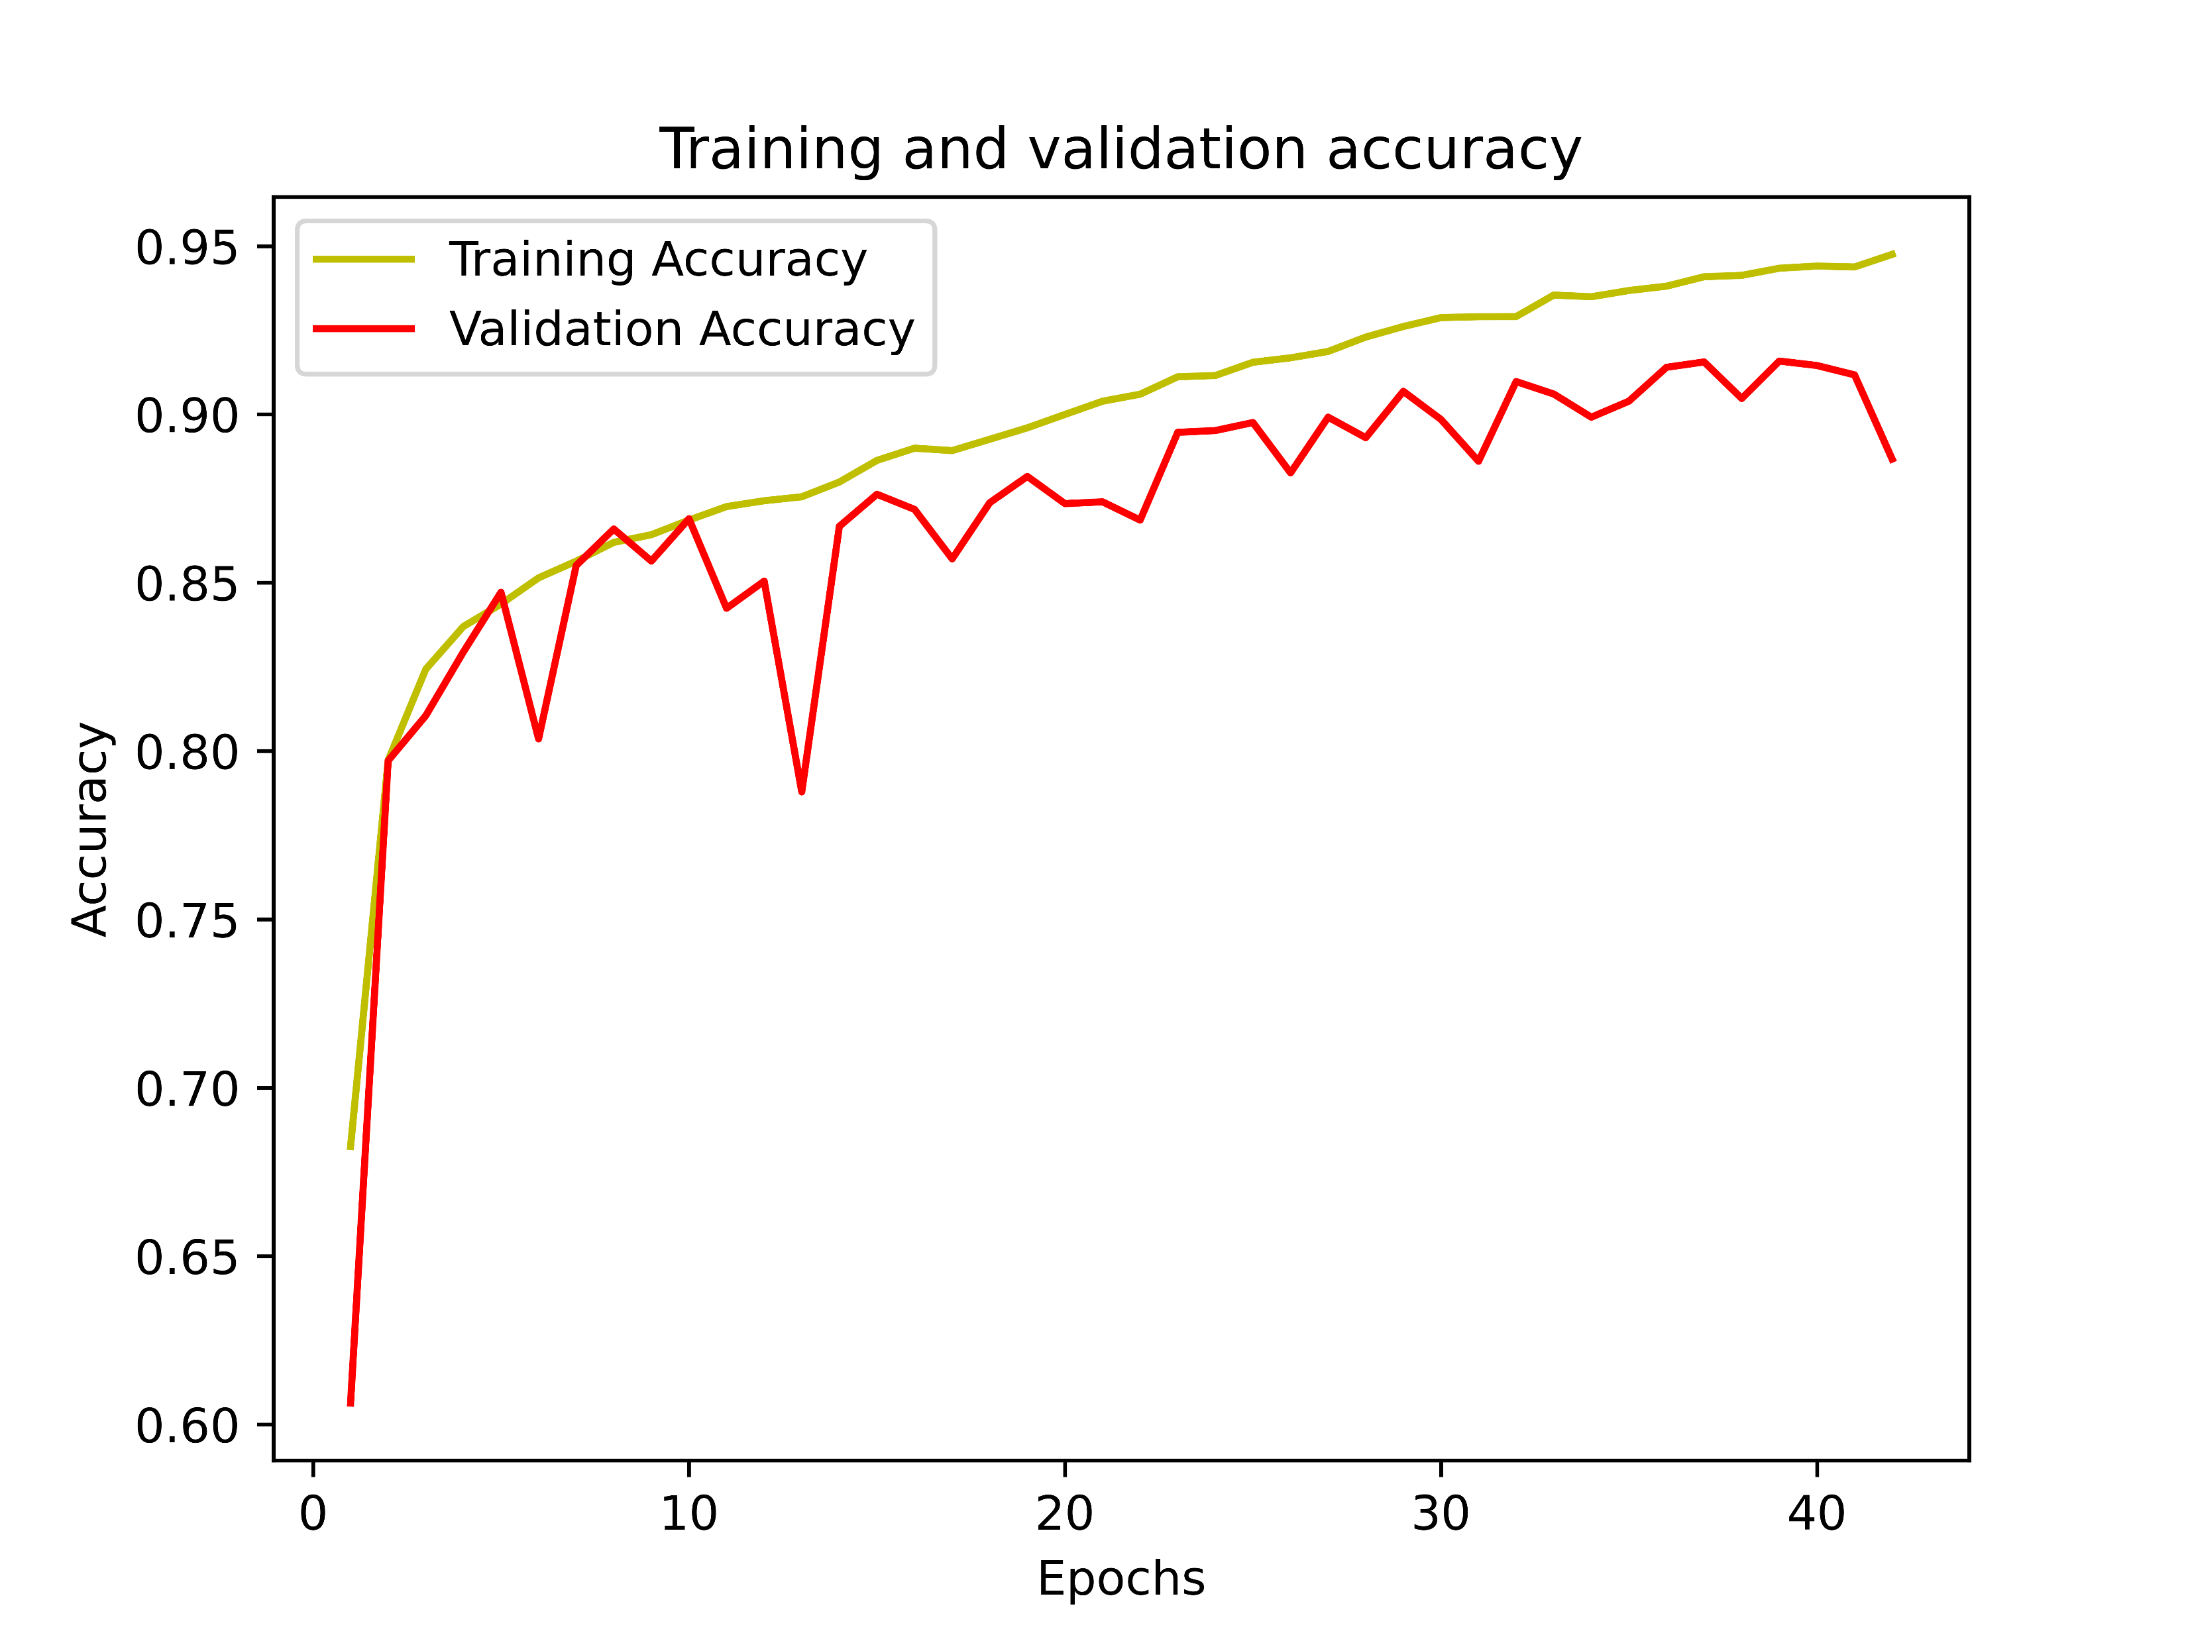
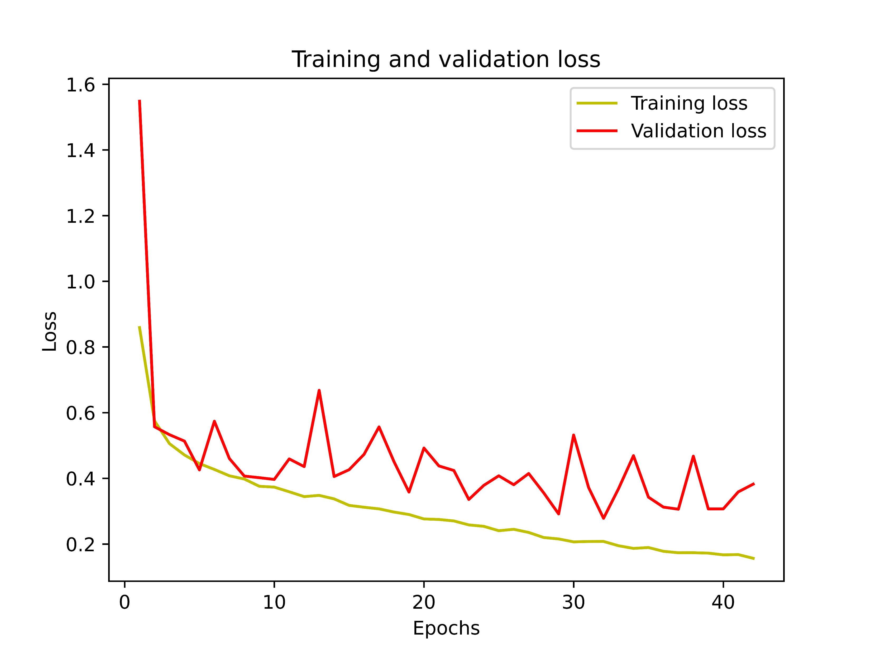
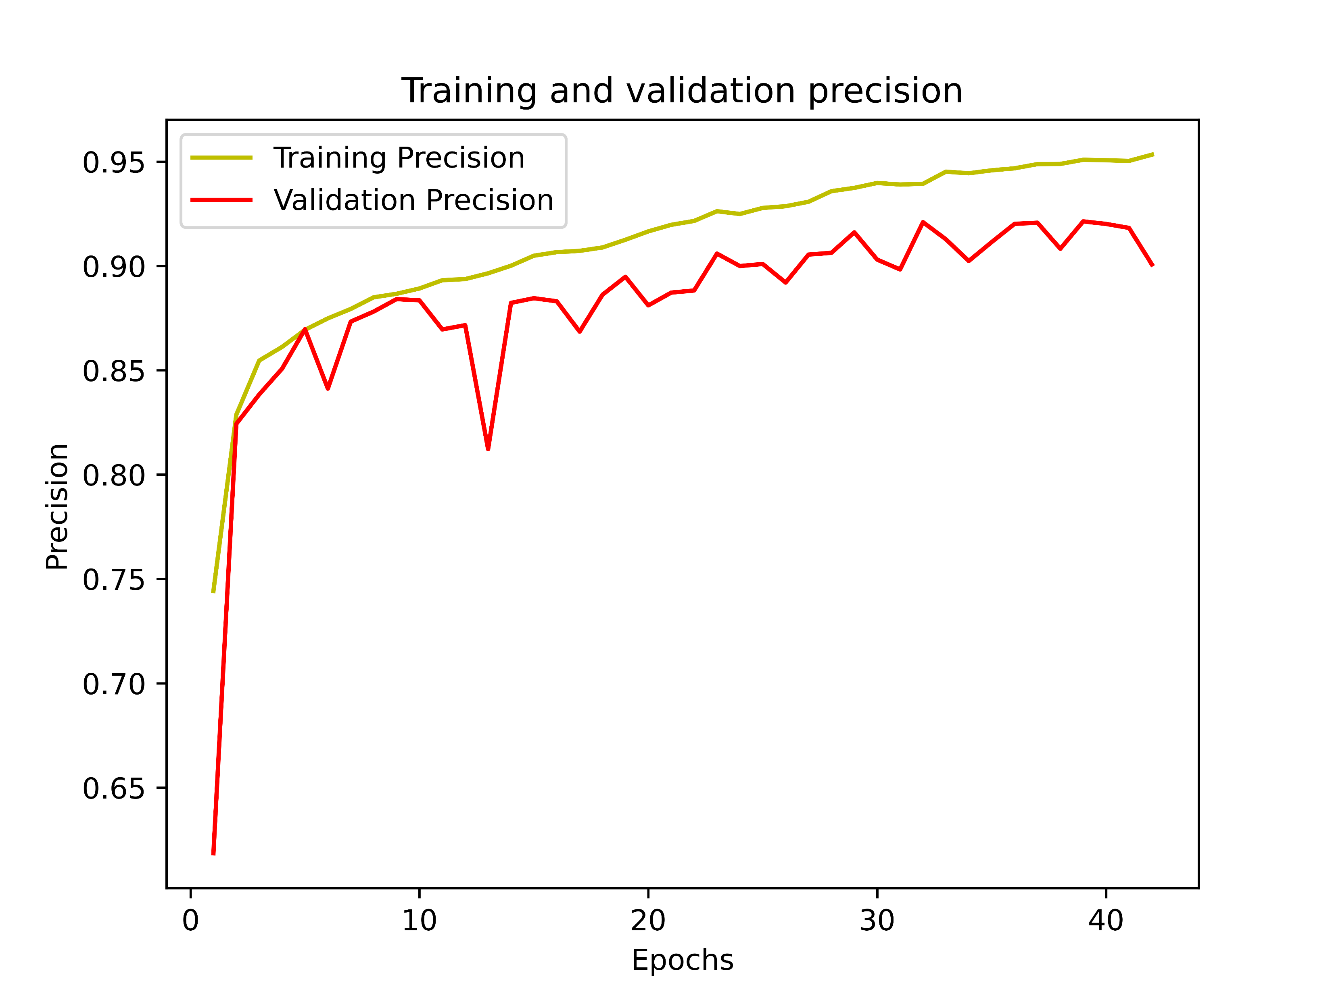
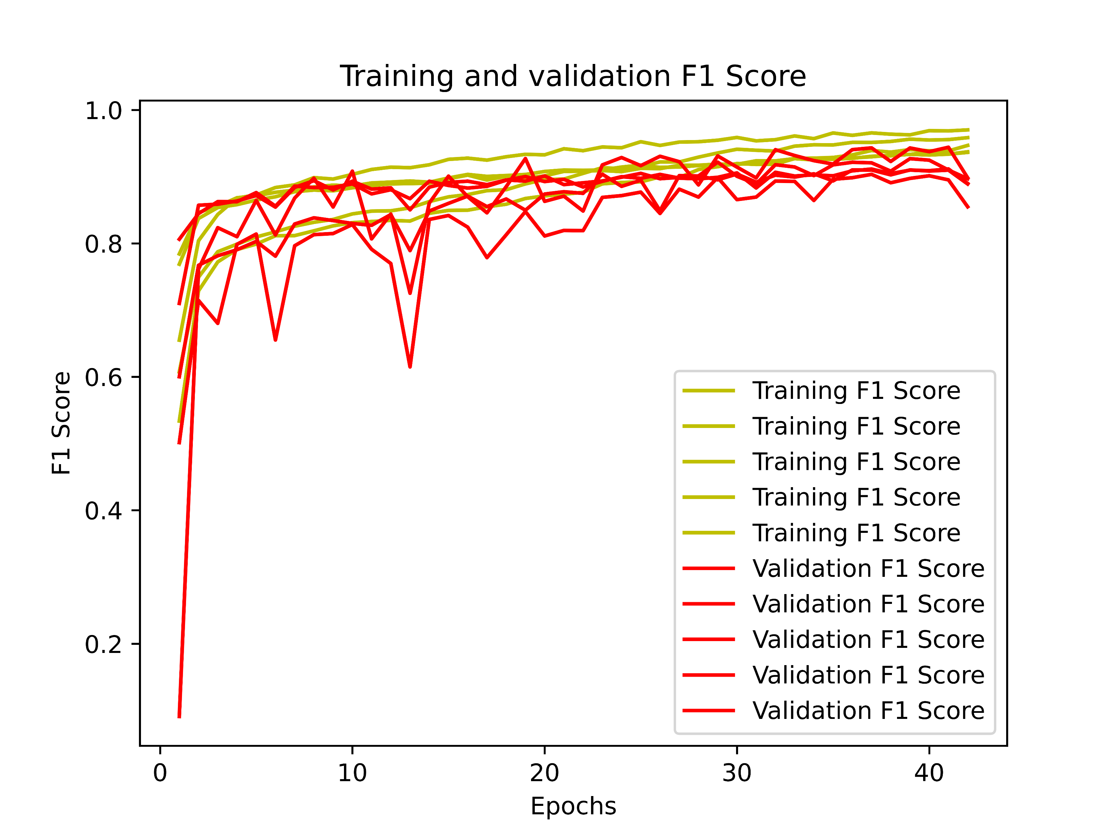
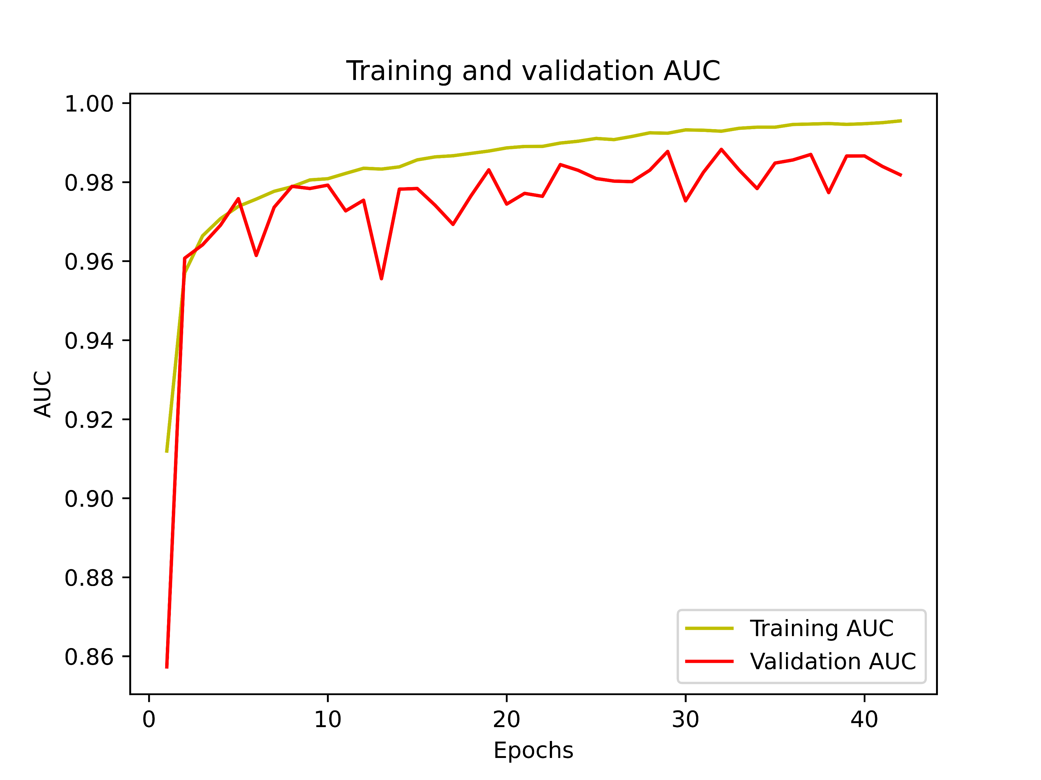
RESULT ANALYSIS(cont’d)
Multi-Class Classification using Attention Network Architecture (Dataset-2):
Figure 15: Accuracy, Loss, Precision, F1-Score, and AUC Curves for Multi-Class Classification on
Dataset-2

Slide 24
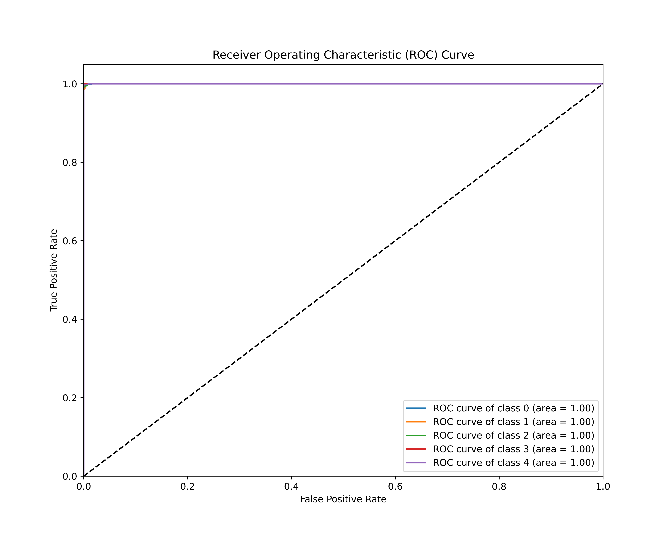
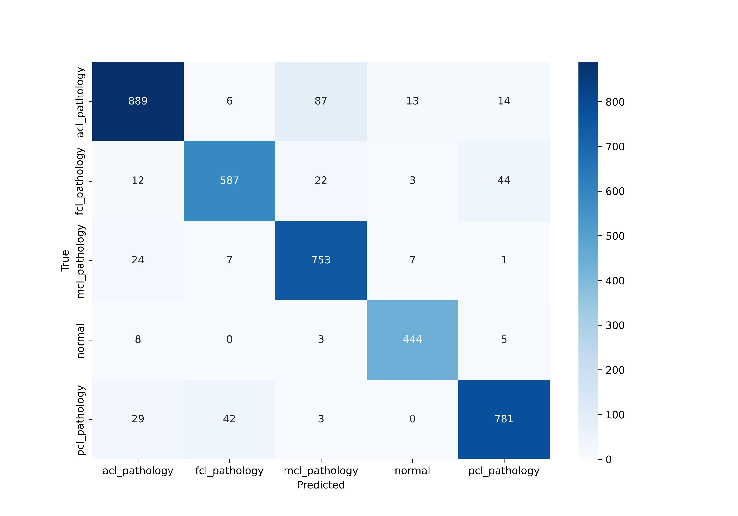
RESULT ANALYSIS(cont’d)
Test results for Dataset-2(Multi-Class Classification) with Attention Architecture :
Figure 16: Testing Results for Multi-Class Classification on Dataset-2

Slide 25
RESULT ANALYSIS(cont’d)
Classification Report for Multi-Class Classification on Dataset -2 using Attention Architecture:
Table 7: Classification Report for Multi-Class Classification
Metrics | Precision | Recall | F1-Score | Support
ACL | 0.92 | 0.88 | 0.90 | 1009
FCL | 0.91 | 0.88 | 0.90 | 668
MCL | 0.97 | 0.95 | 0.91 | 792
Normal | 0.95 | 0.97 | 0.96 | 460
PCL | 0.92 | 0.91 | 0.92 | 855
Accuracy | 0.91 |  |  | 3784
Macro avg | 0.92 | 0.92 | 0.92 | 3784
Weighted avg | 0.91 | 0.91 | 0.91 | 3784

Slide 26
Figure 17: Comparison between various models for binary and multi-class classification.

Slide 27
CONCLUSION
Our study used the Attention Network for knee injury classification with high accuracy.
Our Attention Network outperformed the Inception-v3[3] model in binary and multi-class tasks.
Attention mechanisms enhanced MRI image feature focus, improving accuracy.
Deep learning, especially custom architectures, can transform diagnostic procedures.

Slide 28
FUTURE WORK
We plan to add diverse MRI images to test our model's robustness further.
Integrating techniques like transfer learning or GANs might enhance our model's performance.
We're focusing on enhancing model interpretability for clinician trust.
We'll collaborate with medics for real-world feedback and model refinement.

Slide 29
REFERENCES
[1] "Trends in Australian knee injury rates: An epidemiological analysis of 228,344 knee injuries over 20 years," The Lancet Regional Health - Western Pacific, vol. XX, no. YY, pp. ZZ-ZZ, Apr. 2022.
[2] H. Orthopaedics, “Anterior cruciate ligament tear,” https://www.huangortho.com/
anterior-cruciate-ligament-tear, accessed: Aug. 9, 2023.
[3] Sridhar, S., Amutharaj, J., Valsalan, P., Arthi, B., Ramkumar, S., Mathupriya, S., Rajendran, T. and Waji, Y.A., 2022. A Torn ACL mapping in knee MRI images using deep convolution neural network with Inception-v3. Journal of Healthcare Engineering, 2022.
[4] Wahid, A., Shah, J.A., Khan, A.U., Ullah, M. and Ayob, M.Z., 2020. Multi-layered basis pursuit algorithms for classification of MR images of knee ACL tear. IEEE Access, 8, pp.205424-205435.
[5] Hu, J. (2018) Squeeze-and-Excitation Networks [Preprint]. doi: https://doi.org/10.48550/arXiv.1709.01507.

Slide 30
Thank You!!

